Slide 1
BIS629 Advanced Methods In Implementation Science
Lecture 3: Design and Analysis of Cluster Randomized Trials in Implementation and Prevention Science
Donna Spiegelman, Sc.D.
Susan Dwight Bliss Professor of Biostatistics and
Inaugural Director, Center for Methods in Implementation and Prevention Science
https://ysph.yale.edu/cmips/

Slide 2
NOTES BASED IN PART ON:
Donner A. and Klar N.
Design and Analysis of Cluster Randomization Trials in Health Research. Wiley, 2000
Hayes, R. and Moulton, L.H.
  Cluster Randomised Trials. Chapman & Hall, 2009

Slide 3
What Are Cluster Randomized Trials?
Cluster randomized trials are experiments in which social units or clusters of individuals rather than independent individuals are randomly allocated to intervention groups.

Slide 4
Synonyms
Cluster randomized trials have been adopted by health researchers in a wide range of settings, resulting in a number of essentially synonymous terms:
group randomized trials
place randomized trials
community intervention trials
macro experiments
field or social experiments

Slide 5

Case Study:
The Familia Salama Study
Dar es Salaam, Tanzania

Slide 6
Familia Salama Study
The efficacy and safety of the WHO PMTCT options are well-established and deemed to be equal
  “The currently available scientific and programmatic data do not demonstrate that one strategy is more efficacious than the other” (WHO 2010)
So, policy makers should choose an option based on local circumstances …
  “At a national and programmatic level, the decision for one option should be made according to local circumstances, weighing feasibility, acceptability, values and cost” (WHO 2010)
…. which is difficult in the face of sparse local evidence on feasibility, acceptability, effectiveness and costs
  “It should be noted that the recommendations were not based on cost. Although current cost of drugs was considered, no formal cost-effectiveness analysis was performed” (WHO 2010).

Slide 7
Familia Salama Study
Specific aim 1: To determine the effectiveness and cost-effectiveness of an enhanced community-based strategy to increase access and utilization of Maternal and Child health (MNCH) services, including PMTCT, as compared to the current standard of care (impact and economic evaluation)
Specific aim 2: To establish the feasibility and acceptability of an enhanced community-based strategy to increase access and utilization of MNCH including PMTCT as compared to the current standard of care (process evaluation)
Specific aim 3: To determine effectiveness and cost-effectiveness in PMTCT of providing option B compared to option A to pregnant and breastfeeding HIV-infected women (impact and economic evaluation)
Specific aim 4: To establish the feasibility and acceptability of implementing Option B versus option A for PMTCT (process evaluation)

Slide 8
The study took place in urban Tanzania
Study setting: Ilala and Kinondoni district in Dar es Salaam (DSM)
  Total population: >2,258,000
  HIV prevalence in DSM Region: 9.3% among 15-49 year olds (2nd highest of any region in Tanzania)
    (actual: 5.1% at delivery, 6.0% at the first ANC visit, 6.9% at ANC according to national data 2010)
Planned study duration: 18 months (actual 22 months)
Sample size:
  150,000 pregnancies expected (168,079 observed)
  10,500 pregnancies among HIV-positive women expected (10,135 observed)

Slide 9
Wards were randomized to one of four arms in this cluster-randomized 2x2 factorial implementation trial
60 wards
Community intervention:
36 wards
No community intervention:
24 wards
Option B: 22 wards
(36,540 pregnancies)
Option A: 14 wards
(35,622 pregnancies)
Option B: 10 wards
(44,424 pregnancies)
Option A: 14 wards
(37,098 pregnancies)
Expected: 80,964 B vs. 77,720 A
Observed: 89,014 B vs. 98,419 A
Expected: 72,162 CHW vs. 81,522 SOC
Observed: 103,628 CHW vs. 83,805 SOC

Slide 10
Methodologic challenges in Familia Salama
Challenge I:
Valid and efficient clustered randomization, stratified or not, when the number of observations, here pregnancies, within cluster, here ward, varies by two orders of magnitude
  Three strata: Wards with 1 or more military hospitals / If not, 1 or more high level facilities / Otherwise, Standard facilities

Slide 11
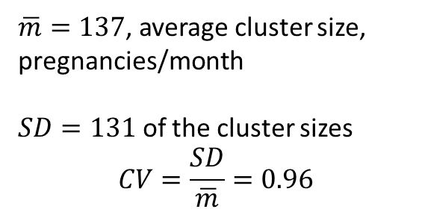
Familia Salama variation in cluster size
DISTRICT | WARD | pmtct | chw | NPREG
KINONDONI | BUNJU | A | CHW | 131
KINONDONI | GOBA | B | CHW | 50
KINONDONI | HANANASIF | B | CHW | 56
KINONDONI | KAWE | A | CHW | 168
KINONDONI | KIBAMBA | B | CHW | 229
KINONDONI | KIGOGO | A | SoC | 144
KINONDONI | KIJITONYAMA | B | SoC | 153
KINONDONI | KIMARA | A | SoC | 18
KINONDONI | KINONDONI | A | SoC | 20
KINONDONI | KUNDUCHI | B | SoC | 310
KINONDONI | KWEMBE | B | SoC | 42
KINONDONI | KWEZI | A | CHW | 0
KINONDONI | MABIBO | B | CHW | 49
KINONDONI | MABWEPANDE | B | SoC | 27
KINONDONI | MAKONGO | B | SoC | 10
KINONDONI | MAKONGO JUU | B | SoC | 272
KINONDONI | MAKUBURI | B | CHW | 93
KINONDONI | MAKUMBUSHO | B | SoC | 39
KINONDONI | MAKURUMLA | B | CHW | 212
KINONDONI | MANZESE | B | SoC | 57
KINONDONI | MAVURUNZA | B | SoC | 28
KINONDONI | MBEZI | A | CHW | 207
KINONDONI | MBEZI JUU | B | SoC | 125
KINONDONI | MBURAHATI | A | CHW | 8
KINONDONI | MBWENI | A | CHW | 50
KINONDONI | MIKOCHENI | A | CHW | 86
KINONDONI | MSASANI | A | CHW | 166
KINONDONI | MSIGANI | B | SoC | 0
KINONDONI | MWANANYAMALA | B | CHW | 62
KINONDONI | MZIMUNI | B | CHW | 30
KINONDONI | NDUGUMBI | A | SoC | 360
KINONDONI | SALANGA | A | CHW | 247
KINONDONI | SINZA | A | SoC | 540
KINONDONI | TANDALE | A | CHW | 193
KINONDONI | UBUNGO | B | CHW | 81
KINONDONI | WAZO | A | CHW | 62
DISTRICT | WARD | pmtct | chw | NPREG
ILALA | BUGURUNI | A | SoC | 398
ILALA | CHANIKA | B | CHW | 98
ILALA | GEREZANI | B | SoC | 37
ILALA | GONGO LA MBOTO | B | CHW | 165
ILALA | ILALA | A | CHW | 220
ILALA | JANGWANI | B | CHW | 39
ILALA | KARIAKOO | A | CHW | 7
ILALA | KIMANGA | B | SoC | 79
ILALA | KINYEREZI | A | SoC | 50
ILALA | KIPAWA | A | CHW | 105
ILALA | KISUTU | B | CHW | 75
ILALA | KITUNDA | B | CHW | 140
ILALA | KIVUKONI | B | CHW | 154
ILALA | KIVULE | A | CHW | 94
ILALA | KIWALANI | B | SoC | 397
ILALA | MAJOHE | B | CHW | 118
ILALA | MCHAFUKOGE | A | SoC | 527
ILALA | MCHIKICHINI | A | SoC | 0
ILALA | MSONGOLA | B | SoC | 77
ILALA | PUGU | B | CHW | 72
ILALA | SEGEREA | B | SoC | 137
ILALA | TABATA | A | CHW | 247
ILALA | UKONGA | A | SoC | 275
ILALA | UPANGA EAST | A | CHW | 40
ILALA | UPANGA WEST | B | SoC | 498
ILALA | VINGUNGUTI | B | CHW | 164
 |  |  |  | 137.7097
 |  |  |  | 131.4348
$\overline{m}=137$, average cluster size, pregnancies/month
$SD=131$ of the cluster sizes
$$CV=\frac{SD}{\overline{m}}=0.96$$

Slide 12
Methodologic challenge 2: estimation and inference for causal effects of treatment
Contamination of intervention status between wards
Non-compliance on the individual and ward level
Possibly non-random loss to follow-up
Risk factor imbalances by treatment arms

Slide 13
Illustration of why randomization does not guarantee unbiasedness in CRTs
Mwanza Trial of Sexually Transmitted Disease Treatment for HIV Prevention, discussed in Hayes and Moulton’s book on cluster randomized trials [1].
This study cluster-randomized 12 rural Tanzanian communities to a sexually transmitted disease preventive intervention or standard of care, matching the communities by expected HIV prevalence rates ranging from 1.6% to 8.6%.
There are 12 choose 6, equal to 924 unique ways to assign 6 of 12 communities to the intervention and 6 to control, and these can be enumerated through combinatorial analysis.
1 2 3 4 5 6
1 2 3 4 5 7
1 2 3 4 5 8
...
6 7 8 10 11 12
6 7 9 10 11 12
6 8 9 10 11 12
7 8 9 10 11 12
[1] Hayes, R. and Moulton, L.H. Cluster Randomised Trials. Chapman & Hall, 2009

Slide 14
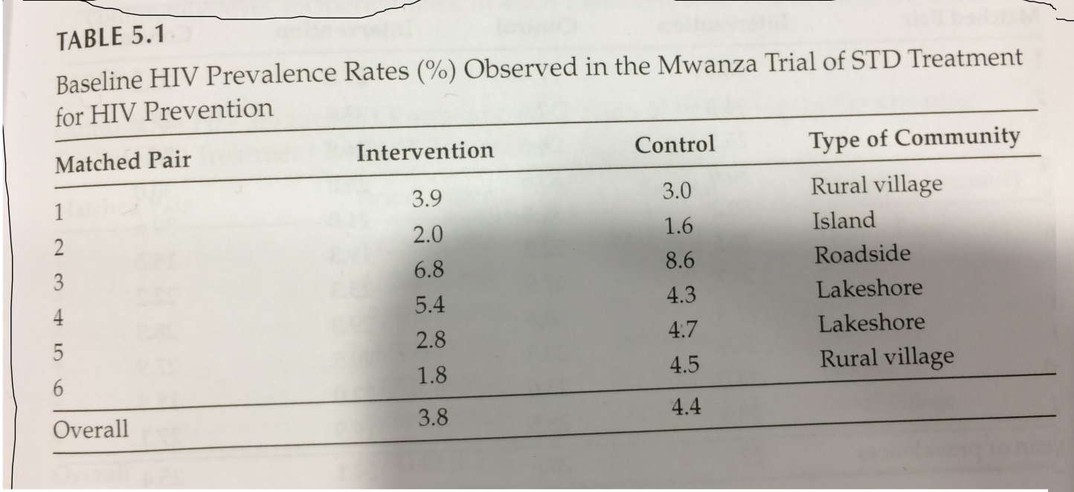






Illustration of why randomization does not guarantee unbiasedness in CRTs
Assuming the range of baseline HIV rates observed in these study communities, ‘bad luck’ randomizations leading to an observed relative risk of 1.1 or greater, or 0.9 or less, would occur, on average, 73% of the time, and ‘bad luck’ randomizations leading to a relative risk of 1.2 or greater or 0.8 or less would occur 50.5% of the time.
For example, with probability 1/924 ≈ 0.1%, the communities with the 6 highest HIV prevalence rates would be randomly assigned to the control and the communities with the 6 lowest to the intervention.
In this case, given the observed rates
(Table 5.1 in [1]), the effect estimate
would be 0.5 on the relative risk
scale, suggesting a strongly beneficial
intervention when there may not be
one at all.

Slide 15
Additional Examples of CRTs (Cluster Randomized Trials):
Medical practices selected as the randomization unit in trials evaluating the efficacy of disease screening programs
Communities or villages selected as the randomization unit in trials evaluating the effectiveness of new vaccines in developing countries
Hospitals selected as the randomization unit in trials evaluating the impact of educational guidelines directed at physicians and/or administrators

Slide 16
Reasons for Adopting Cluster Randomization
Administrative convenience
Intervention naturally applied at the cluster level
To obtain cooperation of investigators
To enhance participant compliance
To avoid treatment group contamination

Slide 17
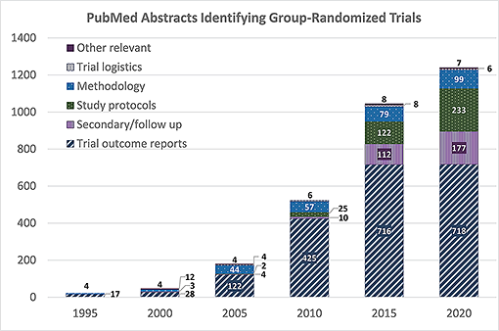
CLUSTER RANDOMIZED TRIALS
PUBLISHED 1981-2020 (Bland, 2004)
Since 1995, there has been an exponential increase in publications utilizing CRT designs and in publications on methods for such designs (Adapted from Murray DM, Taljaard M, Turner EL, George SM. “Essential ingredients and innovations in the design and analysis of group-randomized trials”. Annu Rev Public Health. 2020;41:1–19)

Slide 18
Reviews by Donner et al. [1990], Simpson et al. [1995], Smith et al. [1997], Varnell et al [2004], Eldridge et al [2004], Murray [2008] show improper design and analysis
Only 25% of studies accounted for between-cluster variation when determining trial power.
Only 50% of studies accounted for between-cluster variation in the statistical analysis.

Slide 19
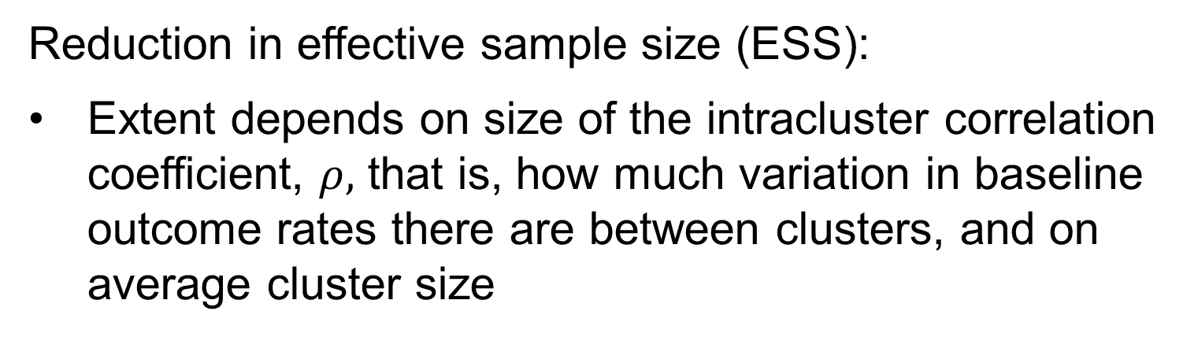
Implications of Intracluster Correlation (ICC)
Reduction in effective sample size (ESS):
Extent depends on size of the intracluster correlation coefficient, $ρ,$ that is, how much variation in baseline outcome rates there are between clusters, and on average cluster size

Slide 20
    Application of standard sample size approaches leads to an underpowered study
    Application of standard statistical methods generally tends to bias p-values downwards, i.e., could lead to spurious statistical significance (increased Type I error -> false positives)

Slide 21
Possible Sources of Intracluster Correlation
1. Participants (we don’t like the word ‘subjects’) frequently select the clusters to which they belong, e.g., when physician is the cluster, patient characteristics that determine endpoint rates could be related to age or sex differences among physicians --- older physicians may be more likely to have older patients, who in turn may have higher event rates
2. Important determinants of endpoint rates that vary by cluster affect all individuals within the cluster in the same manner, e.g., differences in temperature between nurseries may be related to infection rates.

Slide 22
Possible sources of Intracluster Correlation (cont.)
3. Individuals within clusters frequently interact and, as a result, may tend to have more similar endpoint rates, independent of the intervention
e.g., other educational strategies or therapies may be provided in a group setting
Note: the study of ‘interference/spillover/contamination’ within cluster is of great interest and a potential asset for enhancing a scalable intervention
4. Tendency of infectious diseases to spread more rapidly within than among families or hospital wards.

Slide 23
Familia Salama (FS)
In FS, wards may have similar ANC uptake rates due to closer proximity to clinics, or to higher average educational levels in some neighborhoods vs. others
  The intraclass correlation coefficient (ICC) for 4 or more ANC visits during pregnancy was 0.05 (95% CI: 0.03, 0.07)
In FS, some wards may have lower background PMTCT rates due to the higher quality clinics located there, or to better adherence of the mothers due to higher educational levels
Other reasons for intra-ward correlations?

Slide 24

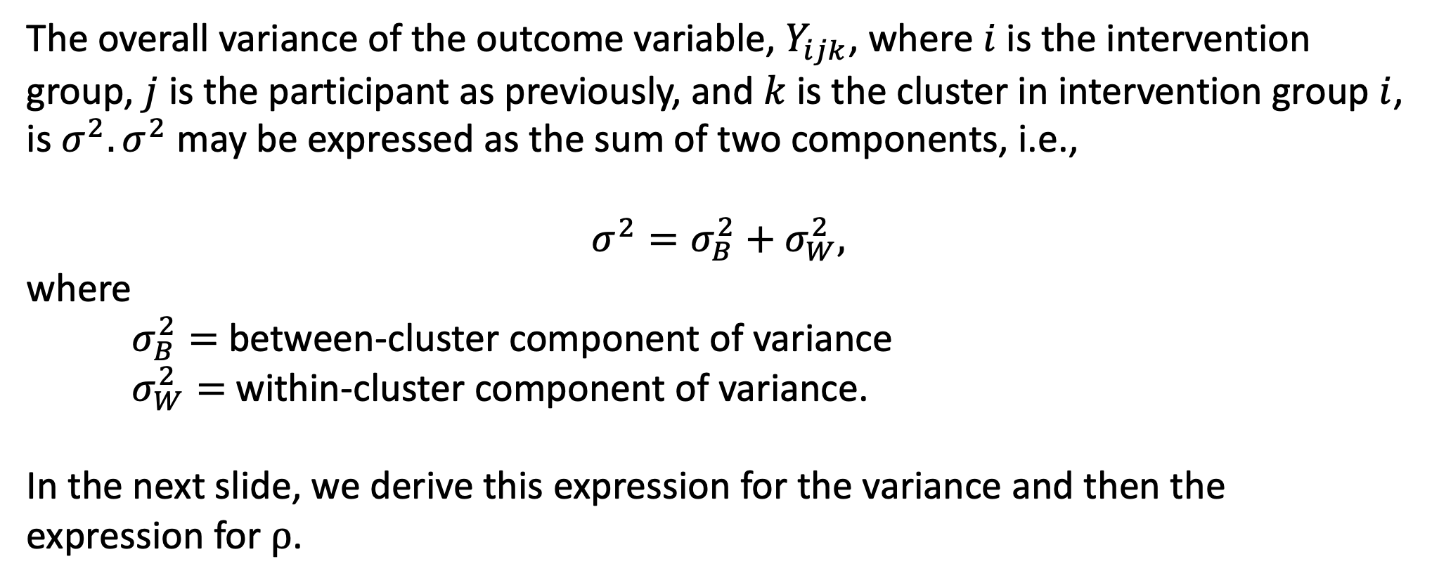
Variance Component Interpretation of $ρ$
The overall variance of the outcome variable, $Y_{ijk}$, where $i$ is the intervention group, $j$ is the participant as previously, and $k$ is the cluster in intervention group $i$, is $σ^{2}.σ^{2}$ may be expressed as the sum of two components, i.e.,
$$σ^{2}=σ_{B}^{2}+σ_{W}^{2},$$
where
$σ_{B}^{2}=$between-cluster component of variance
$σ_{W}^{2}=$within-cluster component of variance.
In the next slide, we derive this expression for the variance and then the expression for $ρ$.

Slide 25

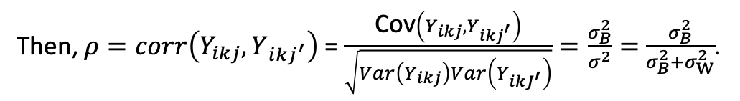
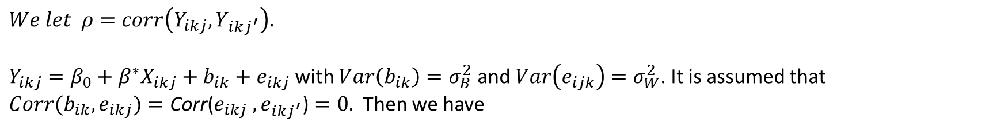



Variance Component Interpretation of $ρ$ (cont.)
$We let ρ=corr\left(Y_{ikj},Y_{ikj^{′}}\right).$
$Y_{ikj}=β_{0}+β^{∗}X_{ikj}+b_{ik}+e_{ikj}$with $Var\left(b_{ik}\right)=σ_{B}^{2}$ and $Var\left(e_{ijk}\right)=σ_{W}^{2}$. It is assumed that ${Corr(b}_{ik},e_{ikj})=\text{Co}\text{rr}\text{(}e_{ikj} ,e_{i{kj}^{′}}\text{)}=0.$ Then we have
Cov$\left(Y_{ikj},Y_{i{kj}^{′}}\right)$ = Cov($β_{0}+β^{∗}X_{ikj}+b_{ik}+e_{ikj}$,${ β}_{0}+β^{∗}X_{ikj}+b_{ik}+e_{ikj^{′}}$)
= Cov($b_{ik}+e_{ikj}$, $b_{ik}+e_{i{kj}^{′}}$)=Cov($b_{ik}$, $b_{ik}$)+2Cov($b_{ik}$, $e_{ikj}$ )+Cov($e_{ikj} ,e_{i{kj}^{′}}$)
$\text{=}\text{Cov}\text{(}b_{ik}\text{,} b_{ik})=$ Var($b_{ik})$
$${=σ}_{B}^{2}$$
$Var\left(Y_{ikj}\right)=σ_{B}^{2}+σ_{W}^{2}$ = $σ^{2}$
Then, $ρ=corr\left(Y_{ikj},Y_{i{kj}^{′}}\right)$ = $\frac{\text{Cov}\left(Y_{ikj},Y_{i{kj}^{′}}\right)}{\sqrt{Var\left(Y_{ikj}\right)Var\left(Y_{i{kJ}^{′}}\right)}}=\frac{σ_{B}^{2}}{σ^{2}}=$ $\frac{σ_{B}^{2}}{σ_{B}^{2}+σ_{W}^{2}}$.
And $σ_{W}^{2}=σ^{2}\left(1−ρ\right)$.

Slide 26
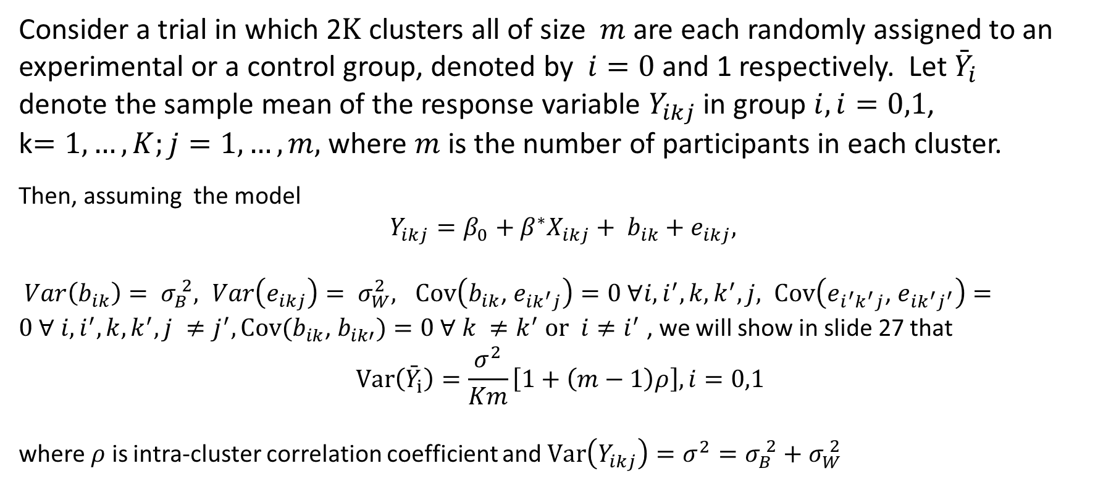
Quantifying the Effect of Clustering
Consider a trial in which 2$K$ clusters all of size $m$ are each randomly assigned to an experimental or a control group, denoted by $i=0$ and 1 respectively. Let ${\bar{Y}}_{i}$ denote the sample mean of the response variable $Y_{ikj}$ in group $i, i=0,1$,
k$=1,…,K;j=1,…,m,$ where $m$ is the number of participants in each cluster.
Then, assuming the model
$Y_{ikj}=β_{0}+β^{∗}X_{ikj}+ b_{ik}+e_{ikj},$
$Var\left(b_{ik}\right)= σ_{B}^{ 2}, Var\left(e_{ikj}\right)= σ_{W}^{2}, Cov\left(b_{ik}\text{, }e_{{ik}^{′}j}\right)=0 ∀i, i^{′}, k, k^{′},j, Cov\left(e_{i^{′}k^{′}j}\text{, }e_{{ik}^{′}j^{′}}\right)=0 ∀ i, i^{′}, k, k^{′},j ≠j^{′}, Cov(b_{ik}\text{, }b_{ik′})=0 ∀ k ≠k^{′}$ $or i≠i^{′}$ , we will show in slide 27 that
$$\text{Var}\left({\bar{Y}}_{i}\right)=\frac{σ^{2}}{Km}\left[1+\left(m−1\right)ρ\right],i=0,1$$
where $ρ$ is intra-cluster correlation coefficient and $Var\left(Y_{ikj}\right)=σ^{2}=σ_{B}^{ 2}+σ_{W}^{ 2}$

Slide 27
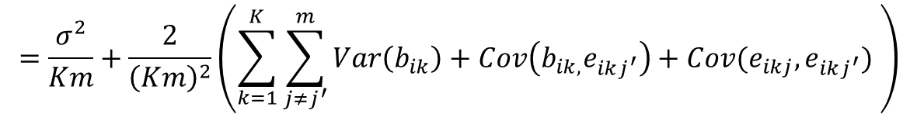

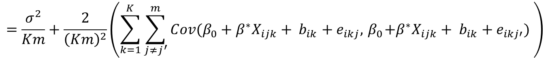

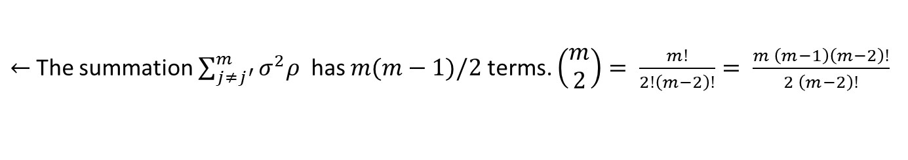
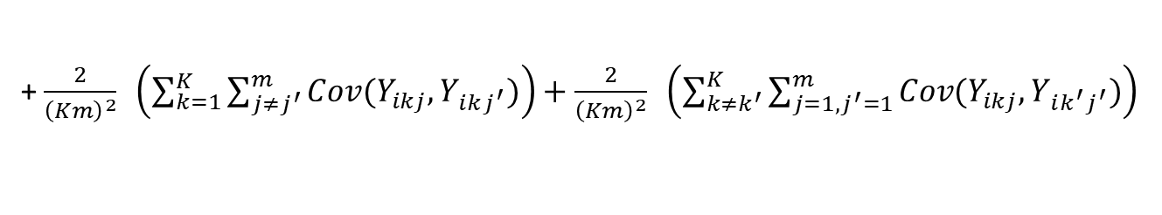

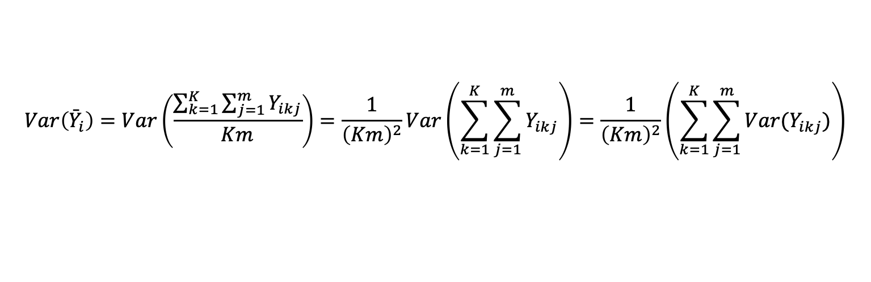




Quantifying the Effect of Clustering
We have ${\bar{Y}}_{i}=\frac{\sum_{k=1}^{K}{\sum_{j=1}^{m}{Y_{ikj}}}}{Km}$, and $ρ=\frac{σ_{B}^{2}}{σ_{B}^{2}+σ_{W}^{2}}$, then
$$Var\left({\bar{Y}}_{i}\right)=Var\left(\frac{\sum_{k=1}^{K}{\sum_{j=1}^{m}{Y_{ikj}}}}{Km}\right)=\frac{1}{{\left(Km\right)}^{2}}Var\left(\sum_{k=1}^{K}{\sum_{j=1}^{m}{Y_{ikj}}}\right)=\frac{1}{{\left(Km\right)}^{2}}\left(\sum_{k=1}^{K}{\sum_{j=1}^{m}{{Var(Y}_{ikj})}}\right)$$
+ $\frac{2}{{\left(Km\right)}^{2}} \left(\sum_{k=1}^{K}{\sum_{j≠j^{′}}^{m}{{Cov(Y}_{ikj},Y_{ikj^{′}})}}\right)+\frac{2}{{\left(Km\right)}^{2}} \left(\sum_{k≠k^{′}}^{K}{\sum_{j=1,j^{′}=1}^{m}{{Cov(Y}_{ikj},Y_{ik^{′}j^{′}})}}\right)$
$$← Cov\left(Y_{ikj}, Y_{ik^{′}j^{′}}\right)=0$$
by definition
$$=\frac{σ^{2}}{Km}+\frac{2}{{\left(Km\right)}^{2}}\left(\sum_{k=1}^{K}{\sum_{j≠j^{′}}^{m}{Cov(β_{0}+β^{∗}X_{ijk}+ b_{ik}+e_{ikj},{ β}_{0}+β^{∗}X_{ijk}+ b_{ik}+e_{ikj′}) }}\right)$$
$←Cov\left(b_{ik},b_{ik}\right)=Var\left(b_{ik}\right)$= $σ_{B}^{ 2}=σ^{2}ρ$
$←β_{0}+β^{∗}$ are fixed effects so no covariance
$$=\frac{σ^{2}}{Km}+\frac{2}{{\left(Km\right)}^{2}}\left(\sum_{k=1}^{K}{\sum_{j≠j^{′}}^{m}{Var\left(b_{ik}\right)+Cov\left(b_{ik,}e_{ikj^{′}}\right)+Cov(e_{ikj},e_{ikj^{′}}) }}\right)$$
$←Cov\left(b_{ik,}e_{ikj^{′}}\right)$=0
$← Cov(e_{ikj},e_{ikj^{′}}$)=0
$←$The summation $\sum_{j≠j^{′}}^{m}{σ^{2}ρ}$ has $m(m−1)/2$terms. $\left(\begin{aligned}m \\ 2\end{aligned}\right)= \frac{m!}{2!\left(m−2\right)!}= \frac{m \left(m−1\right)\left(m−2\right)!}{2 \left(m−2\right)!}$
$=\frac{σ^{2}}{Km}+\frac{1}{{\left(Km\right)}^{2}}\left(\sum_{k=1}^{K}{\sum_{j≠j^{′}}^{m}{σ^{2}ρ}}\right)=$ $\frac{σ^{2}}{Km}+\frac{2}{{\left(Km\right)}^{2}}K\frac{m \left(m−1\right)}{2}σ^{2}ρ$
= $\frac{σ^{2}}{Km}\left[1+\left(m−1\right)ρ\right]$

Slide 28
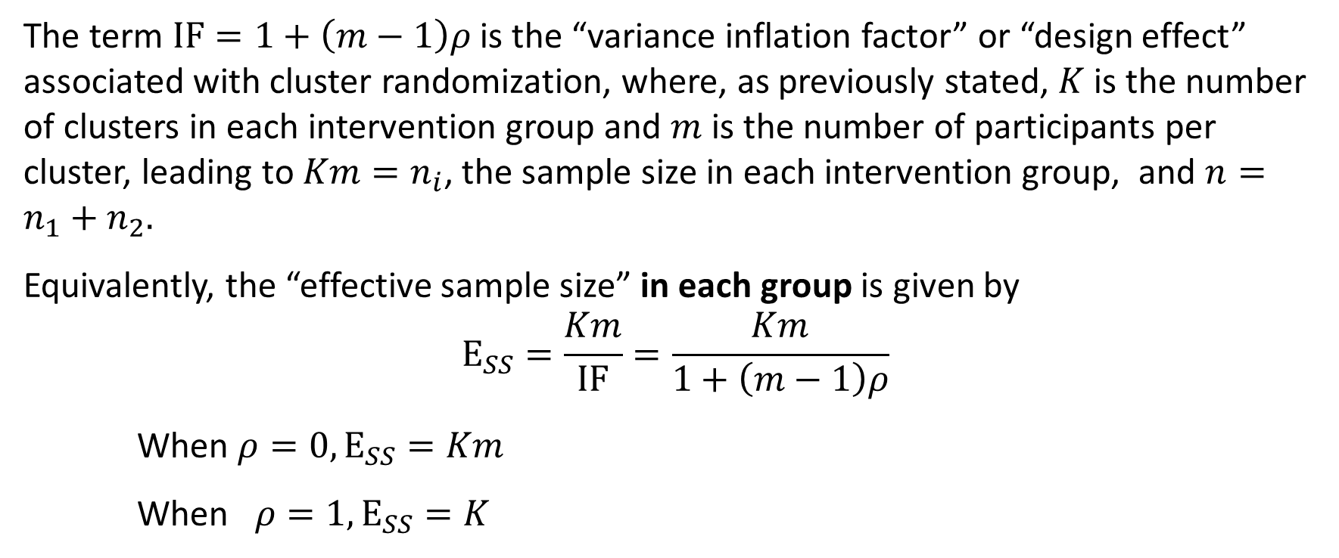
The term $ΙF=1+\left(m−1\right)ρ$ is the “variance inflation factor” or “design effect” associated with cluster randomization, where, as previously stated, $K$ is the number of clusters in each intervention group and $m$ is the number of participants per cluster, leading to $Km=n_{i}$, the sample size in each intervention group, and $n=n_{1}+n_{2}.$
Equivalently, the “effective sample size” in each group is given by
$$Ε_{SS}=\frac{Km}{ΙF}=\frac{Km}{1+\left(m−1\right)ρ}$$
When $ρ=0,Ε_{SS}=Km$
When $ρ=1,Ε_{SS}=K$

Slide 29
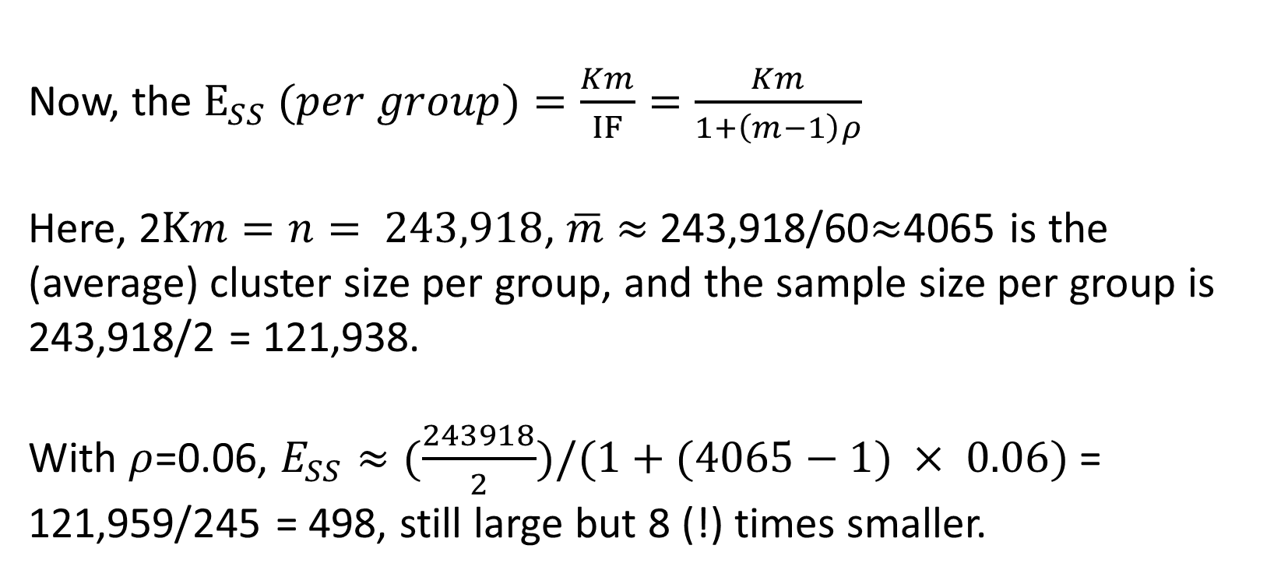
Example: Familia Salama
Now, the $Ε_{SS} (per group)=\frac{Km}{ΙF}=\frac{Km}{1+\left(m−1\right)ρ}$
Here, 2$Km=n= 243,918$, $\overline{m}$ $≈$243,918/60$≈$4065 is the (average) cluster size per group, and the sample size per group is 243,918/2 = 121,938.
With $ρ$=0.06, $E_{SS}≈(\frac{243918}{2})/(1+(4065−1) × 0.06)$= 121,959/245 = 498, still large but 8 (!) times smaller.

Slide 30

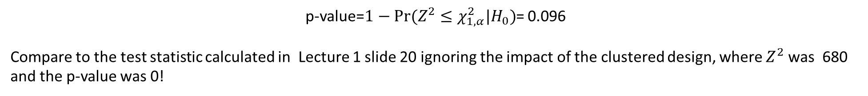
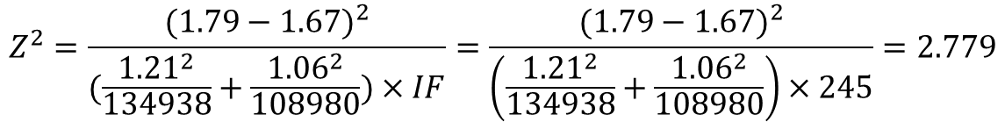
Example: Familia Salama
Group | Intervention | SoC | Total
Sample Size | N=134,938 | N=108,980 | N=243,918
Proportion of >=4 ANC visit | 12,560/134,938 (9.3%) | 7,155/108,980 (6.6%) | 19,715/243,918 (8.1%)
ICC (95% CI) for Proportion of >=4 ANC visits | 0.05 (0.03, 0.07) | 0.07 (0.05, 0.11) | 0.05 (0.03, 0.07)
Mean (SD) for number of ANC visits | 1.79 (1.21) | 1.67 (1.06) | 1.74 (1.15)
ICC (95% CI) for number of ANC visits | 0.07 (0.05,0.10) | 0.10 (0.07,0.15) | 0.06 (0.04,0.08)
$IF=1+\left(m−1\right)ρ$ = $1+4064× 0.06=245$
$$Z^{2}=\frac{{(1.79−1.67)}^{2}}{(\frac{{1.21}^{2}}{134938}+\frac{{1.06}^{2}}{108980})×IF}=\frac{{(1.79−1.67)}^{2}}{\left(\frac{{1.21}^{2}}{134938}+\frac{{1.06}^{2}}{108980}\right)×245}=2.779$$
p-value=$1−Pr⁡(Z^{2}≤χ_{1,α}^{2}|H_{0})$= 0.096
Compare to the test statistic calculated in Lecture 1 slide 20 ignoring the impact of the clustered design, where $Z^{2}$ was 680
and the p-value was 0!

Slide 31
Types of CRTs
COMPLETELY RANDOMIZED CRT
Example:
To evaluate the effectiveness of vitamin A supplements on childhood mortality.
450 villages in Indonesia were randomly assigned to either participate in a vitamin A supplementation program or serve as a control. One year mortality rates were compared in the two groups.
Sommer et al. (1986)

Slide 32
The Importance of Cluster Level Replication
Some investigators have designed community intervention trials in which exactly one cluster has been assigned to each intervention group.
Such trials result in interpretational difficulties caused by the confounding of two sources of variation:
  The variation in response due to the effect of intervention, and
  The natural variation that exists between the two communities (clusters) even in the absence of an intervention effect.
  If treatment heterogeneity is suspected, the intervention effect is not estimable

Slide 33
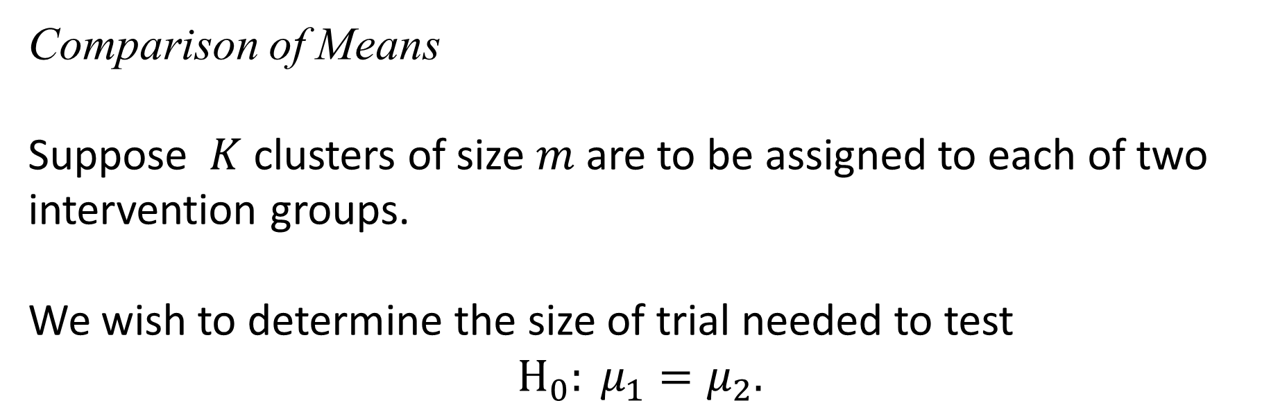
Sample Size Requirements for Completely Randomized Designs
Comparison of Means
Suppose $K$ clusters of size $m$ are to be assigned to each of two intervention groups.
We wish to determine the size of trial needed to test
$$Η_{0}: μ_{1}=μ_{2}.$$

Slide 34
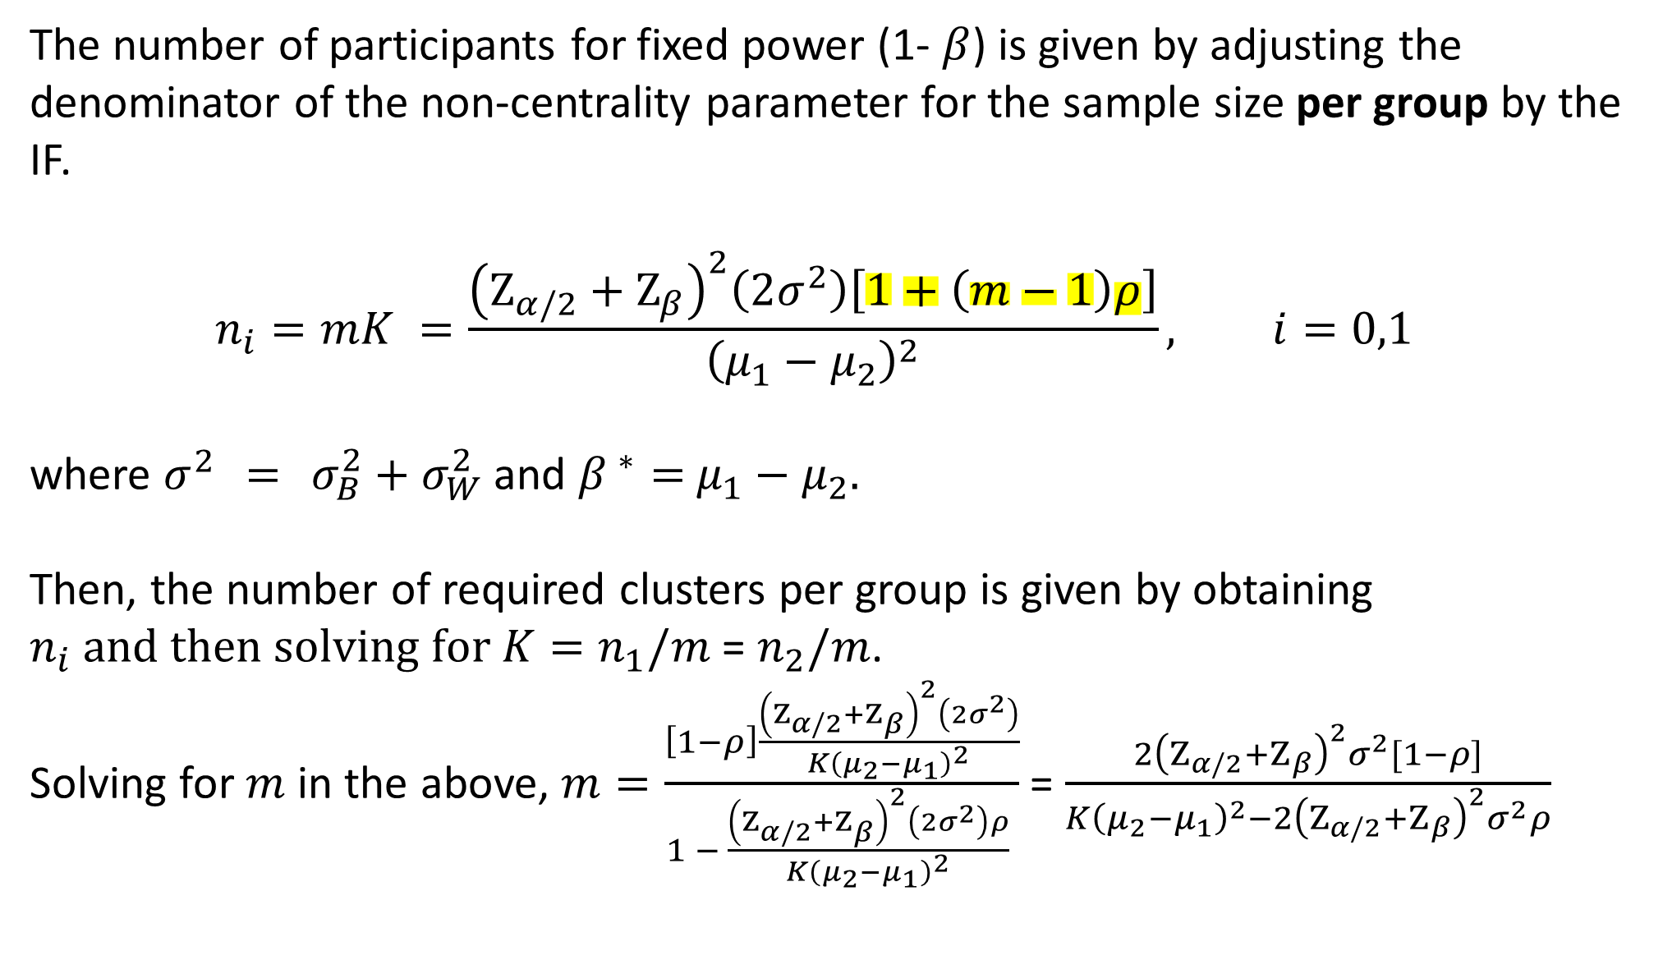
The number of participants for fixed power (1- $β$) is given by adjusting the denominator of the non-centrality parameter for the sample size per group by the IF.
$$n_{i}=mK =\frac{{\left(Ζ_{α/2}+Ζ_{β}\right)}^{2}\left(2σ^{2}\right)\left[1+\left(m−1\right)ρ\right]}{{\left(μ_{1}−μ_{2}\right)}^{2}}, i=0,1$$
where $σ^{2} = σ_{B}^{2}+σ_{W}^{2}$ and ${β }^{∗}=$ $μ_{1}−μ_{2}.$
Then, the number of required clusters per group is given by obtaining $n_{i} and then solving for K=n_{1}/m$ = $n_{2}/m$.
Solving for $m$ in the above, $m=\frac{\left[1−ρ\right]\frac{{\left(Ζ_{α/2}+Ζ_{β}\right)}^{2}\left(2σ^{2}\right)}{K{\left(μ_{2}−μ_{1}\right)}^{2}}}{1 − \frac{{\left(Ζ_{α/2}+Ζ_{β}\right)}^{2}\left(2σ^{2}\right)ρ}{K{\left(μ_{2}−μ_{1}\right)}^{2}} }$ = $\frac{2{\left(Ζ_{α/2}+Ζ_{β}\right)}^{2}σ^{2}[1−ρ]}{K{\left(μ_{2}−μ_{1}\right)}^{2}−2{\left(Ζ_{α/2}+Ζ_{β}\right)}^{2}σ^{2}ρ}$

Slide 35
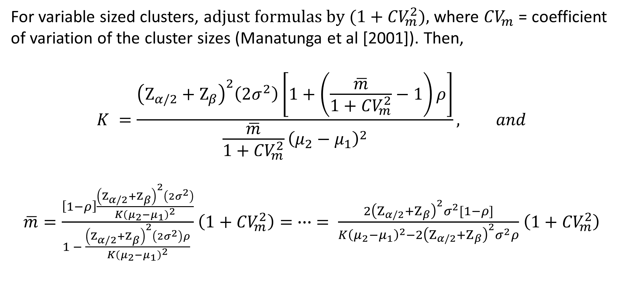
For variable sized clusters, a$djust formulas by (1+{CV}_{m}^{2}),$ where ${CV}_{m}$ = coefficient of variation of the cluster sizes (Manatunga et al [2001]). Then,
$$K =\frac{{\left(Ζ_{α/2}+Ζ_{β}\right)}^{2}\left(2σ^{2}\right)\left[1+\left(\frac{\overline{m}}{1+{CV}_{m}^{2}}−1\right)ρ\right]}{\frac{\overline{m}}{1+{CV}_{m}^{2}}{\left(μ_{2}−μ_{1}\right)}^{2}}, and$$
$\overline{m}=\frac{\left[1−ρ\right]\frac{{\left(Ζ_{α/2}+Ζ_{β}\right)}^{2}\left(2σ^{2}\right)}{K{\left(μ_{2}−μ_{1}\right)}^{2}}}{1 − \frac{{\left(Ζ_{α/2}+Ζ_{β}\right)}^{2}\left(2σ^{2}\right)ρ}{K{\left(μ_{2}−μ_{1}\right)}^{2}} }$ $\left(1+{CV}_{m}^{2}\right)= ∙∙∙ = \frac{2{\left(Ζ_{α/2}+Ζ_{β}\right)}^{2}σ^{2}[1−ρ]}{K{\left(μ_{2}−μ_{1}\right)}^{2}−2{\left(Ζ_{α/2}+Ζ_{β}\right)}^{2}σ^{2}ρ}$ $\left(1+{CV}_{m}^{2}\right)$

Slide 36
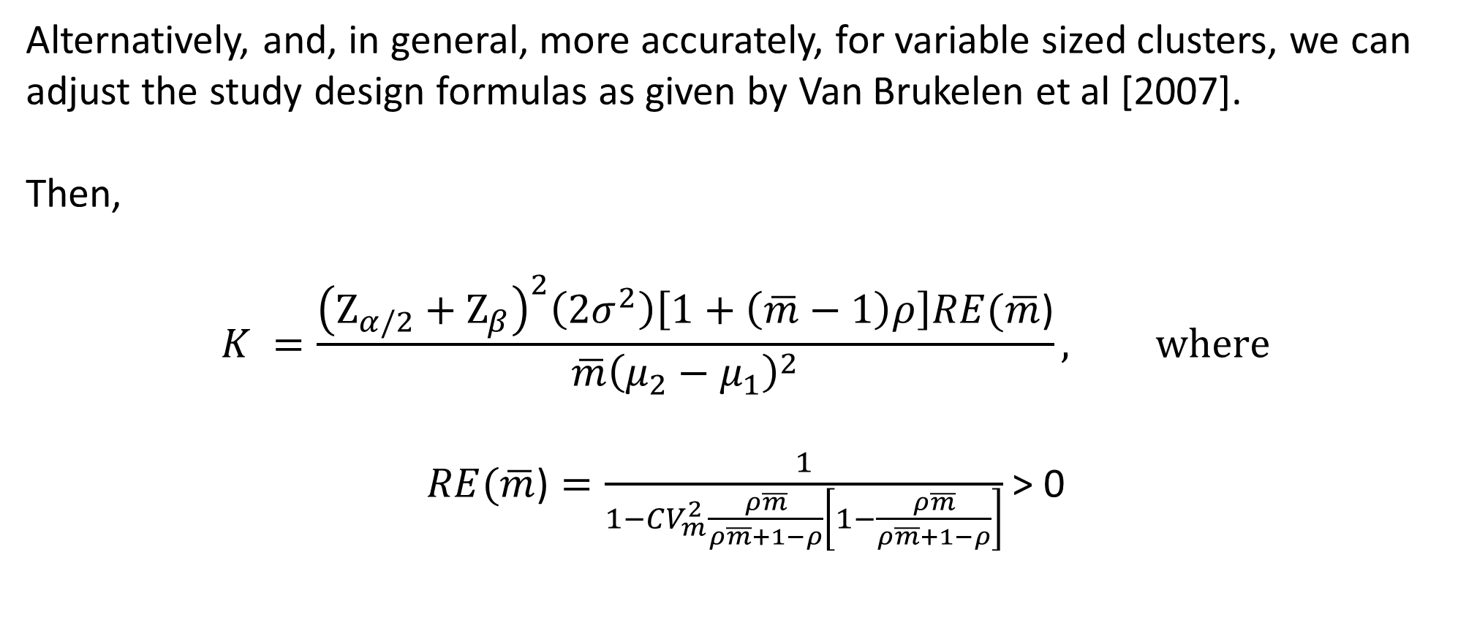
Alternatively, and, in general, more accurately, for variable sized clusters, we can adjust the study design formulas as given by Van Brukelen et al [2007].
Then,
$$K =\frac{{\left(Ζ_{α/2}+Ζ_{β}\right)}^{2}\left(2σ^{2}\right)\left[1+\left(\overline{m}−1\right)ρ\right]RE(\overline{m}\text{)}}{\overline{m}{\left(μ_{2}−μ_{1}\right)}^{2}}, where$$
$RE(\overline{m}\text{)}=\frac{1}{1−CV_{m}^{2}\frac{ρ\overline{m}}{ρ\overline{m}+1−ρ}\left[1−\frac{ρ\overline{m}}{ρ\overline{m}+1−ρ}\right]}$ > 0
van Breukelen, G. J. P., Candel, M. J. J. M., & Berger, M. P. F. (2007). Relative efficiency of unequal versus equal cluster sizes in cluster randomized and multicentre trials. Statistics in Medicine, 26(13), 2589-2603. https://doi.org/10.1002/sim.2740

Slide 37
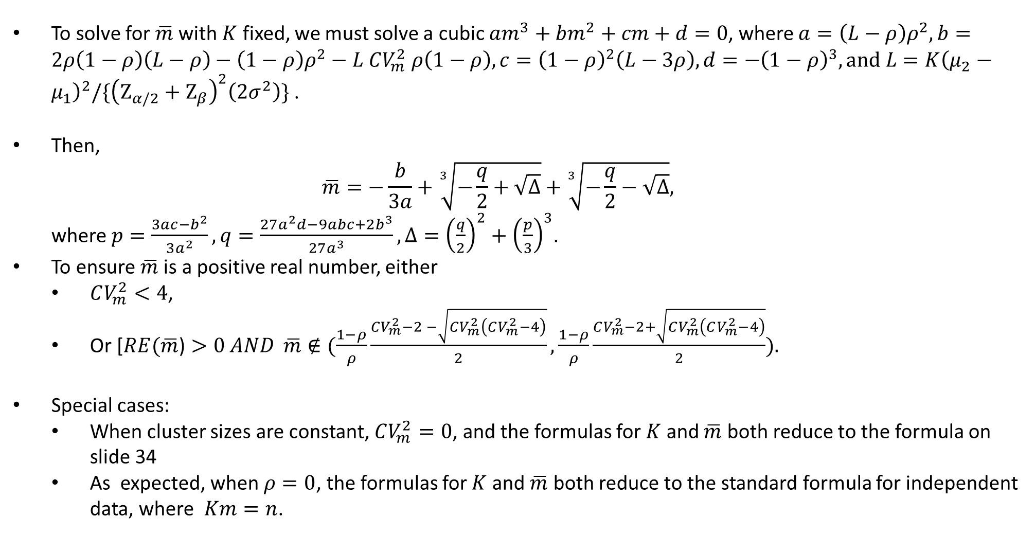
To solve for $\overline{m}$with $K$ fixed, we must solve a cubic $am^{3}+bm^{2}+cm+d=0$, where $a=\left(L−ρ\right)ρ^{2}, b=2ρ\left(1−ρ\right)\left(L−ρ\right)−\left(1−ρ\right)ρ^{2}−L CV_{m}^{2} ρ\left(1−ρ\right), c={\left(1−ρ\right)}^{2}\left(L−3ρ\right), d=−{\left(1−ρ\right)}^{3},\text{and} L=K{\left(μ_{2}−μ_{1}\right)}^{2}/\{{\left(Ζ_{α/2}+Ζ_{β}\right)}^{2}\left(2σ^{2}\right)\} \text{.}$
Then,
$\overline{m}=−\frac{b}{3a}+\sqrt[3]{−\frac{q}{2}+\sqrt{Δ}}+\sqrt[3]{−\frac{q}{2}−\sqrt{Δ}},$
where $p=\frac{3ac−b^{2}}{3a^{2}}, q=\frac{27a^{2}d−9abc+2b^{3}}{27a^{3}}, Δ={\left(\frac{q}{2}\right)}^{2}+{\left(\frac{p}{3}\right)}^{3}$.
To ensure $\overline{m}$is a positive real number, either
  $CV_{m}^{2}<4$,
  Or [$RE(\overline{m}\text{)}>0 AND$ $\overline{m}∉(\frac{1−ρ}{ρ}\frac{CV_{m}^{2}−2 −\sqrt{CV_{m}^{2}\left(CV_{m}^{2}−4\right)}}{2},\frac{1−ρ}{ρ}\frac{CV_{m}^{2}−2+\sqrt{CV_{m}^{2}\left(CV_{m}^{2}−4\right)}}{2}).$
Special cases:
  When cluster sizes are constant, $CV_{m}^{2}=0$, and the formulas for $K$ and $\overline{m}$ both reduce to the formula on slide 34
  As expected, when $ρ=0$, the formulas for $K$ and $\overline{m}$ both reduce to the standard formula for independent data, where $Km=n$.

Slide 38


Familia Salama: quantifying variation in cluster size through ${CV}_{m}$
DISTRICT | WARD | pmtct | chw | NPREG
KINONDONI | BUNJU | A | CHW | 131
KINONDONI | GOBA | B | CHW | 50
KINONDONI | HANANASIF | B | CHW | 56
KINONDONI | KAWE | A | CHW | 168
KINONDONI | KIBAMBA | B | CHW | 229
KINONDONI | KIGOGO | A | SoC | 144
KINONDONI | KIJITONYAMA | B | SoC | 153
KINONDONI | KIMARA | A | SoC | 18
KINONDONI | KINONDONI | A | SoC | 20
KINONDONI | KUNDUCHI | B | SoC | 310
KINONDONI | KWEMBE | B | SoC | 42
KINONDONI | KWEZI | A | CHW | 0
KINONDONI | MABIBO | B | CHW | 49
KINONDONI | MABWEPANDE | B | SoC | 27
KINONDONI | MAKONGO | B | SoC | 10
KINONDONI | MAKONGO JUU | B | SoC | 272
KINONDONI | MAKUBURI | B | CHW | 93
KINONDONI | MAKUMBUSHO | B | SoC | 39
KINONDONI | MAKURUMLA | B | CHW | 212
KINONDONI | MANZESE | B | SoC | 57
KINONDONI | MAVURUNZA | B | SoC | 28
KINONDONI | MBEZI | A | CHW | 207
KINONDONI | MBEZI JUU | B | SoC | 125
KINONDONI | MBURAHATI | A | CHW | 8
KINONDONI | MBWENI | A | CHW | 50
KINONDONI | MIKOCHENI | A | CHW | 86
KINONDONI | MSASANI | A | CHW | 166
KINONDONI | MSIGANI | B | SoC | 0
KINONDONI | MWANANYAMALA | B | CHW | 62
KINONDONI | MZIMUNI | B | CHW | 30
KINONDONI | NDUGUMBI | A | SoC | 360
KINONDONI | SALANGA | A | CHW | 247
KINONDONI | SINZA | A | SoC | 540
KINONDONI | TANDALE | A | CHW | 193
KINONDONI | UBUNGO | B | CHW | 81
KINONDONI | WAZO | A | CHW | 62
DISTRICT | WARD | pmtct | chw | NPREG
ILALA | BUGURUNI | A | SoC | 398
ILALA | CHANIKA | B | CHW | 98
ILALA | GEREZANI | B | SoC | 37
ILALA | GONGO LA MBOTO | B | CHW | 165
ILALA | ILALA | A | CHW | 220
ILALA | JANGWANI | B | CHW | 39
ILALA | KARIAKOO | A | CHW | 7
ILALA | KIMANGA | B | SoC | 79
ILALA | KINYEREZI | A | SoC | 50
ILALA | KIPAWA | A | CHW | 105
ILALA | KISUTU | B | CHW | 75
ILALA | KITUNDA | B | CHW | 140
ILALA | KIVUKONI | B | CHW | 154
ILALA | KIVULE | A | CHW | 94
ILALA | KIWALANI | B | SoC | 397
ILALA | MAJOHE | B | CHW | 118
ILALA | MCHAFUKOGE | A | SoC | 527
ILALA | MCHIKICHINI | A | SoC | 0
ILALA | MSONGOLA | B | SoC | 77
ILALA | PUGU | B | CHW | 72
ILALA | SEGEREA | B | SoC | 137
ILALA | TABATA | A | CHW | 247
ILALA | UKONGA | A | SoC | 275
ILALA | UPANGA EAST | A | CHW | 40
ILALA | UPANGA WEST | B | SoC | 498
ILALA | VINGUNGUTI | B | CHW | 164
 |  |  |  | 137.7097
 |  |  |  | 131.4348
$$\overline{m}=137$$
$$SD=131$$
$$CV=0.96$$

Slide 39
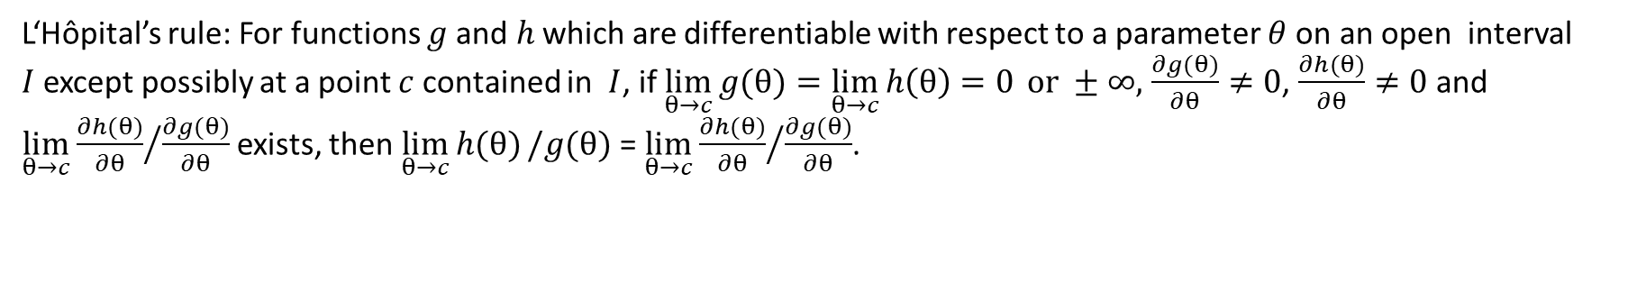
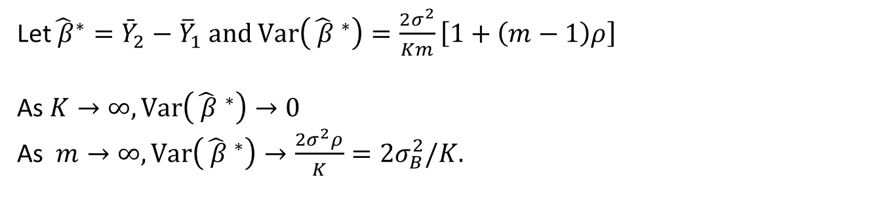
IMPACT ON POWER OF INCREASING THE NUMBER OF CLUSTERS VS. INCREASING CLUSTER SIZE:
Let${\hat{ β}}^{∗}={\bar{Y}}_{2}−{\overline{Y}}_{1}$and $\text{Var}\left({\hat{ β} }^{∗}\right)=\frac{2σ^{2}}{Km}\left[1+\left(m−1\right)ρ\right]$
As $K→∞,\text{Var}\left({\hat{ β} }^{∗}\right)→0$
As $m→∞,\text{Var}\left({\hat{ β} }^{∗}\right)→\frac{2σ^{2}ρ}{K}=2σ_{B}^{2}/K.$
Proof
L‘Hôpital’s rule: For functions $g$and$h$ which are differentiable with respect to a parameter $θ$on an open interval $I$except possibly at a point $c$ contained in $I$, if $\lim_{θ→c}{g(θ)}=\lim_{θ→c}{h\left(θ\right)=0 }or ±∞,$ $\frac{∂g(θ)}{∂θ}≠0$, $\frac{∂h(θ)}{∂θ}≠0$and $\lim_{θ→c}{{\frac{∂h(θ)}{∂θ}}/{\frac{∂g(θ)}{∂θ} }}$exists, then $\lim_{θ→c}{h(θ)}/g(θ)$ = $\lim_{θ→c}{{\frac{∂h(θ)}{∂θ}}/{\frac{∂g(θ)}{∂θ}}}$.
Here, we have $h\left(m\right)=2σ^{2}\left[1+\left(m−1\right)ρ\right]$ and $\frac{∂h(m)}{∂m}=2σ^{2}ρ$, $g\left(m\right)=Km$ with $\frac{ ∂g(m)}{∂m}=K$ , so that
$$\lim_{m→∞}{\text{Var}\left({\hat{ β}}^{∗}\right)}=\lim_{m→∞}{\frac{2σ^{2}\left[1+\left(m−1\right)ρ\right]}{Km}=\lim_{m→∞}\frac{2σ^{2}ρ}{K}=\frac{2σ_{B}^{2}}{K}}$$

Slide 40
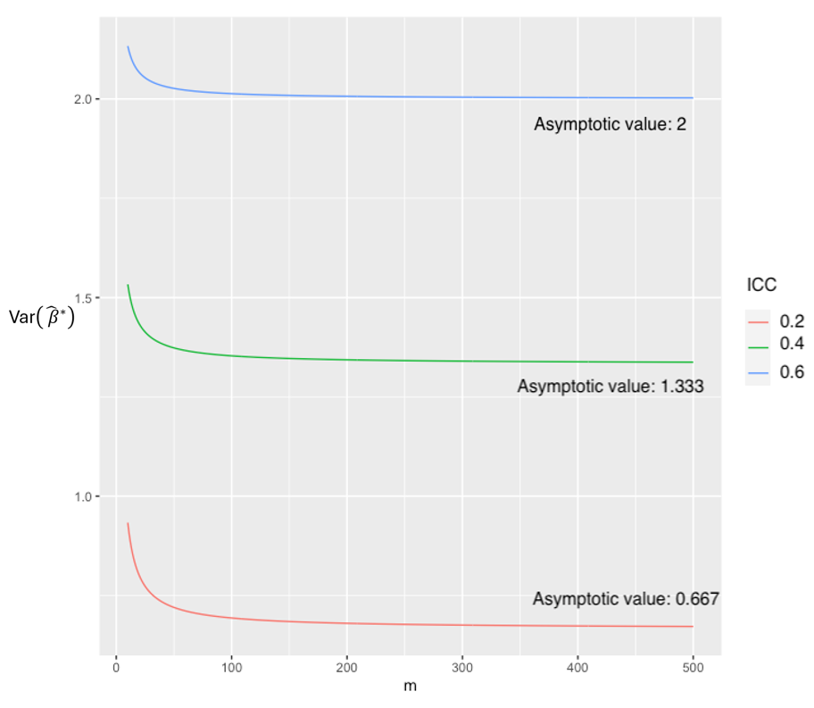
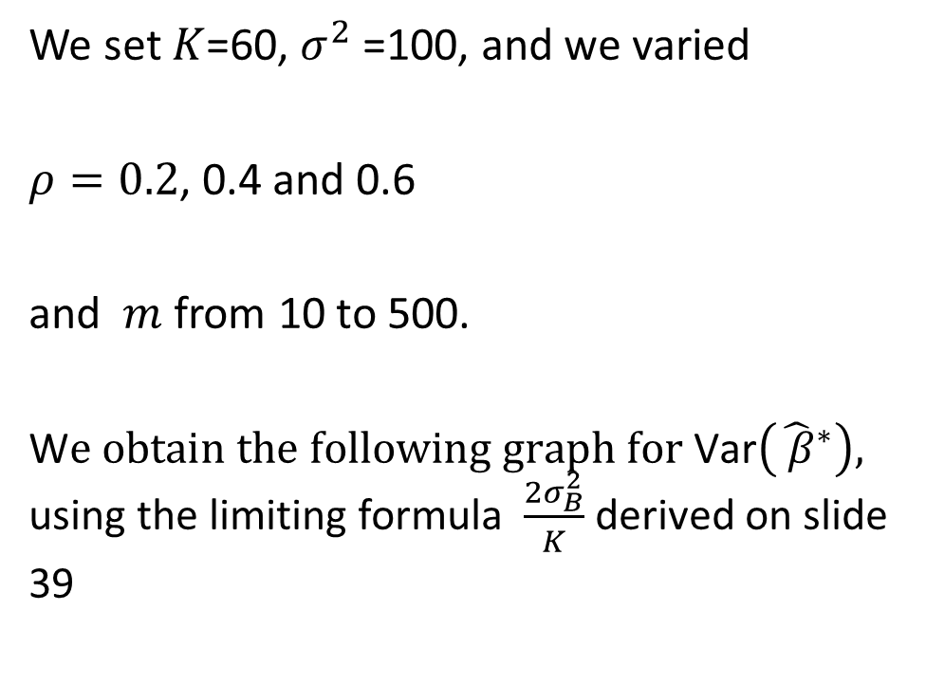
IMPACT ON POWER OF INCREASING THE NUMBER OF CLUSTERS VS. INCREASING CLUSTER SIZE:
IMPACT ON POWER OF INCREASING THE NUMBER OF CLUSTERS VS. INCREASING CLUSTER SIZE
We set $K$=60, $σ^{2}$=100, and we varied
$ρ=0.2$, 0.4 and 0.6
and $m$ from 10 to 500.
W$e obtain the following graph for \text{Var}\left({\hat{ β}}^{∗}\right),$
using the limiting formula $\frac{2σ_{B}^{2}}{K}$ derived on slide 39

Slide 41
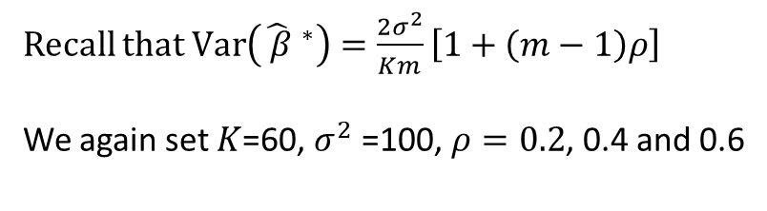
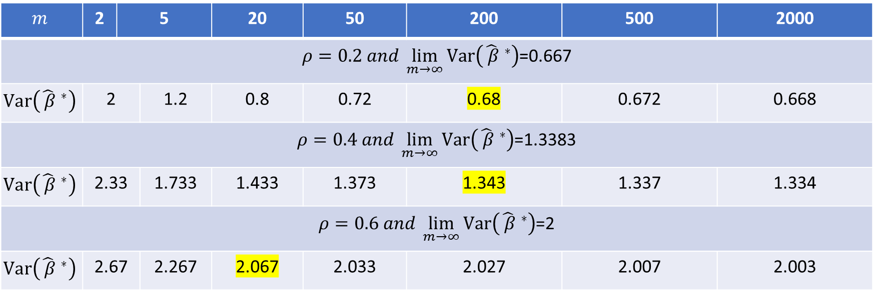
IMPACT ON POWER OF INCREASING THE NUMBER OF CLUSTERS VS. INCREASING CLUSTER SIZE:
IMPACT ON POWER OF INCREASING THE NUMBER OF CLUSTERS VS. INCREASING CLUSTER SIZE
Recall that $\text{Var}\left({\hat{ β} }^{∗}\right)=\frac{2σ^{2}}{Km}\left[1+\left(m−1\right)ρ\right]$
We again set $K$=60, $σ^{2}$=100, $ρ=0.2$, 0.4 and 0.6
$$m$$ | 2 | 5 |  | 20 | 50 | 200 | 500 | 2000
$ρ=0.2 and \lim_{m→∞}{\text{Var}\left({\hat{ β} }^{∗}\right)}$=0.667
$$\text{Var}\left({\hat{ β} }^{∗}\right)$$ | 2 | 1.2 | 1.2 | 0.8 | 0.72 | 0.68 | 0.672 | 0.668
$ρ=0.4 and \lim_{m→∞}{\text{Var}\left({\hat{ β} }^{∗}\right)}$=1.3383
$$\text{Var}\left({\hat{ β} }^{∗}\right)$$ | 2.33 | 1.733 | 1.733 | 1.433 | 1.373 | 1.343 | 1.337 | 1.334
$ρ=0.6 and \lim_{m→∞}{\text{Var}\left({\hat{ β} }^{∗}\right)}$=2
$$\text{Var}\left({\hat{ β} }^{∗}\right)$$ | 2.67 | 2.267 | 2.267 | 2.067 | 2.033 | 2.027 | 2.007 | 2.003

Slide 42
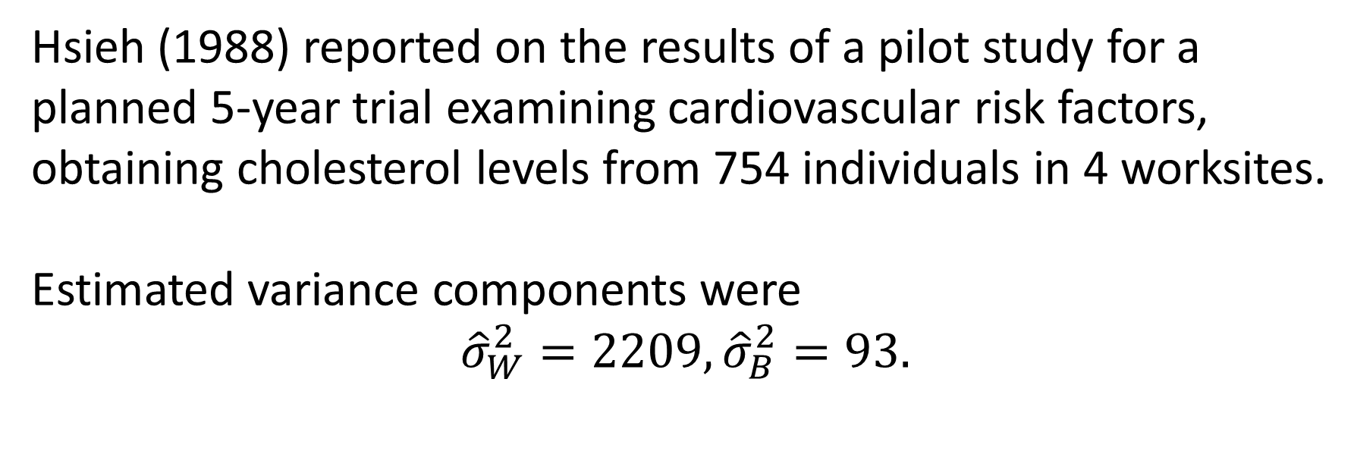
Example
Hsieh (1988) reported on the results of a pilot study for a planned 5-year trial examining cardiovascular risk factors, obtaining cholesterol levels from 754 individuals in 4 worksites.
Estimated variance components were
$${\hat{σ}}_{W}^{2}=2209,{\hat{σ}}_{B}^{2}=93.$$

Slide 43
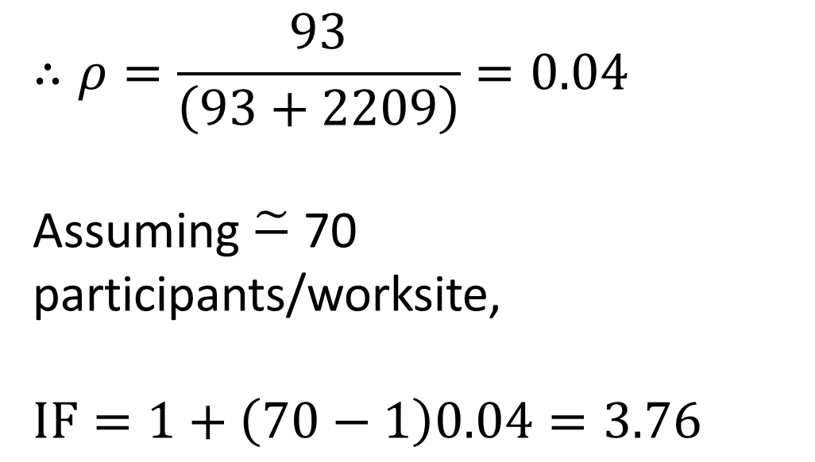
$$∴ρ=\frac{93}{\left(93+2209\right)}=0.04$$
Assuming $\tilde{−}$ 70 participants/worksite,
$$\text{IF}=1+\left(70−1\right)0.04=3.76$$

Slide 44
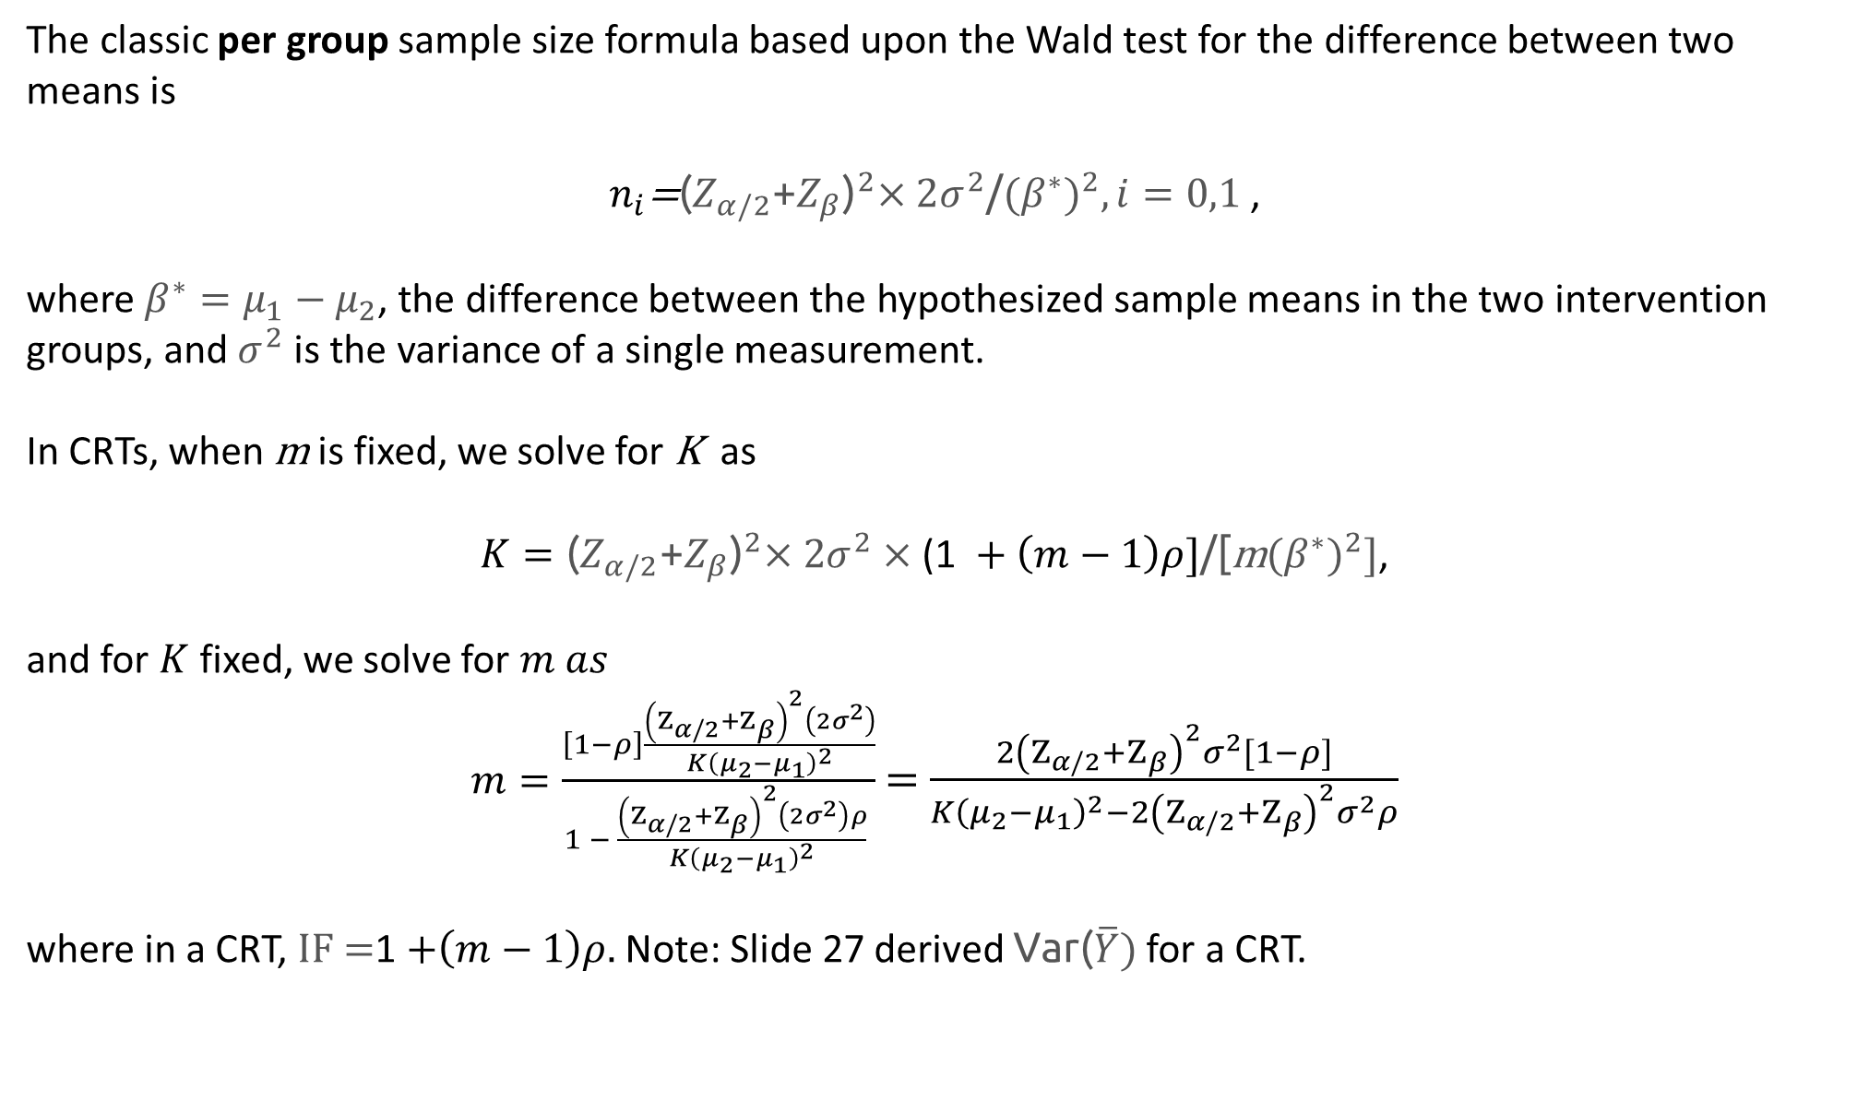
The classic per group sample size formula based upon the Wald test for the difference between two means is
$n_{i}\text{=}{\text{(}Z_{α/2}\text{+}Z_{β}\text{)}}^{2}×\text{2}σ^{2}\text{/}{{(β}^{∗})}^{2}, i=0,1$,
where $β^{∗}=μ_{1}−μ_{2}$, the difference between the hypothesized sample means in the two intervention groups, and $σ^{2}$ is the variance of a single measurement.
In CRTs, when m is fixed, we solve for K as
$K={\text{(}Z_{α/2}\text{+}Z_{β}\text{)}}^{2}×\text{2}σ^{2}×\text{(1} +\left(m−1\right)ρ]\text{/}\text{[}\text{m}{{(β}^{∗})}^{2}]$,
and for $K$fixed, we solve for $m as$
$m=\frac{\left[1−ρ\right]\frac{{\left(Ζ_{α/2}+Ζ_{β}\right)}^{2}\left(2σ^{2}\right)}{K{\left(μ_{2}−μ_{1}\right)}^{2}}}{1 − \frac{{\left(Ζ_{α/2}+Ζ_{β}\right)}^{2}\left(2σ^{2}\right)ρ}{K{\left(μ_{2}−μ_{1}\right)}^{2}} }$ $=$ $\frac{2{\left(Ζ_{α/2}+Ζ_{β}\right)}^{2}σ^{2}[1−ρ]}{K{\left(μ_{2}−μ_{1}\right)}^{2}−2{\left(Ζ_{α/2}+Ζ_{β}\right)}^{2}σ^{2}ρ}$
where in a CRT, $\text{IF}\text{ =}$1 $+\left(m−1\right)ρ.$ Note: Slide 27 derived $\text{Var}\text{(}\overline{Y}\text{)}$ for a CRT.

Slide 45
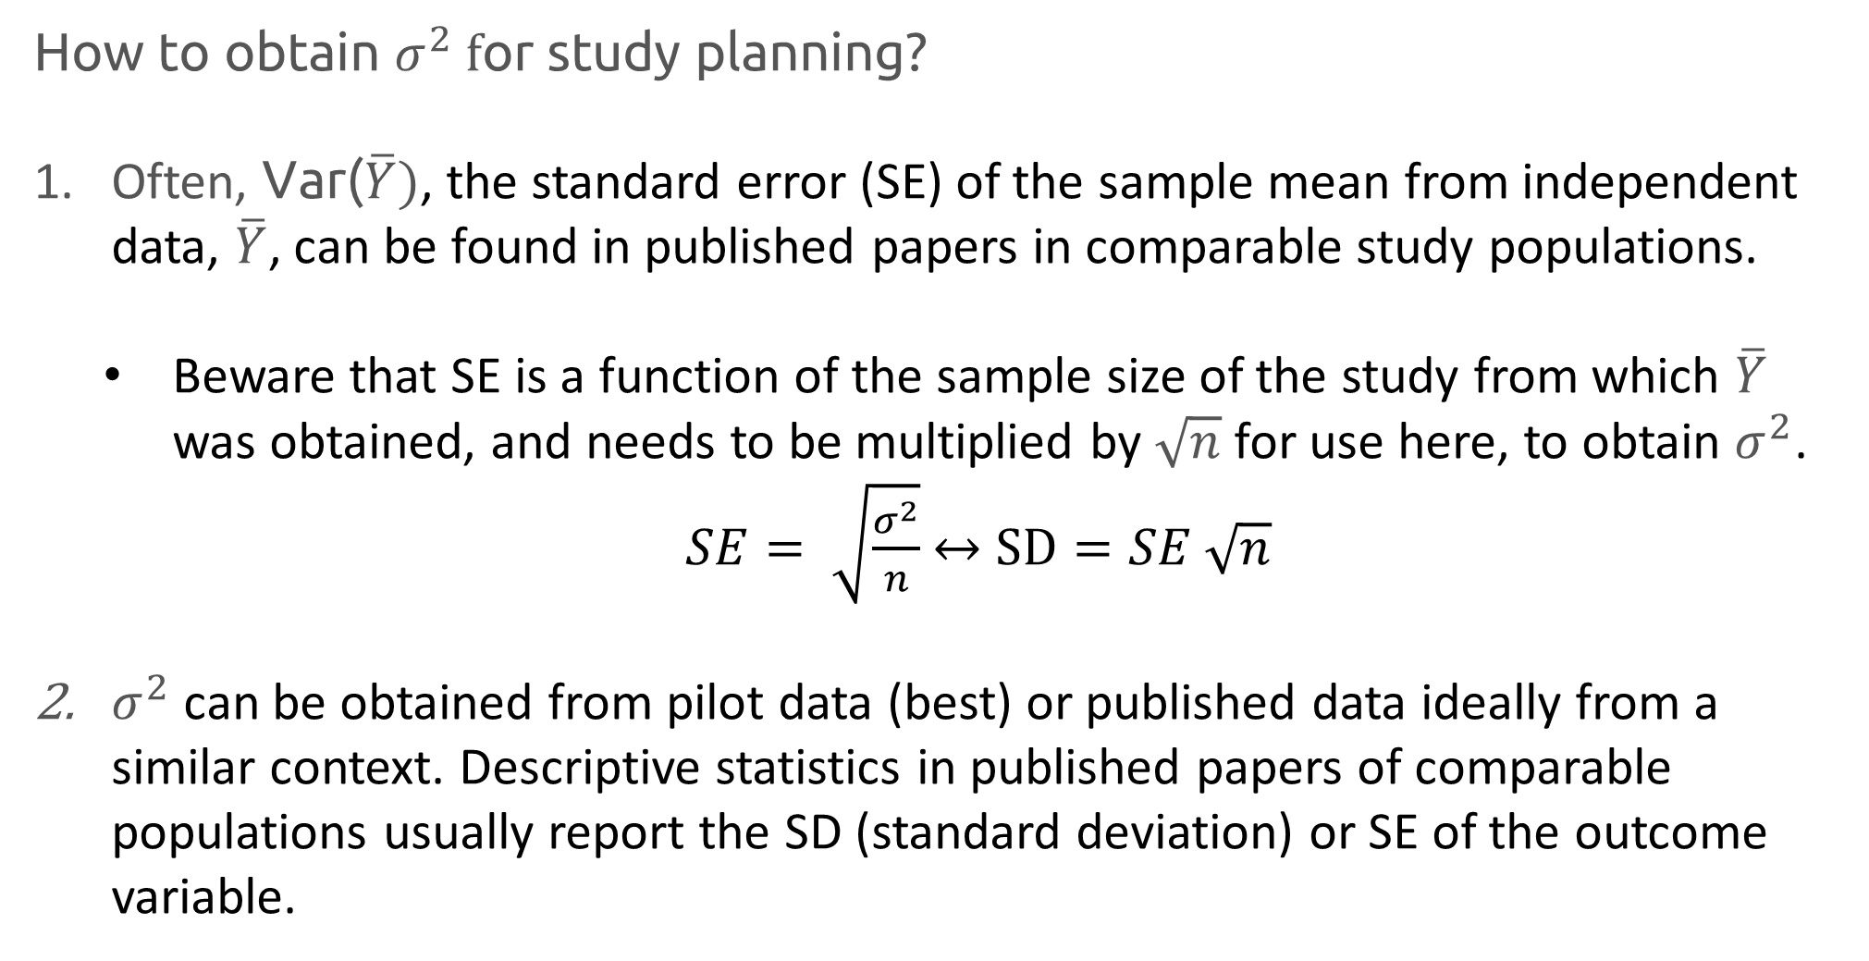
$\text{How} \text{to} \text{obtain} σ^{2} f$or study planning?
Often, $\text{Var}\text{(}\overline{Y}\text{)}$, the standard error (SE) of the sample mean from independent data, $\overline{Y}$, can be found in published papers in comparable study populations.
  Beware that SE is a function of the sample size of the study from which $\overline{Y}$ was obtained, and needs to be multiplied by $\sqrt{n}$ for use here, to obtain $σ^{2}$.
  $SE= \sqrt{\frac{σ^{2}}{n}}$ $↔$ $SD=SE \sqrt{n}$
$σ^{2}$ can be obtained from pilot data (best) or published data ideally from a similar context. Descriptive statistics in published papers of comparable populations usually report the SD (standard deviation) or SE of the outcome variable.

Slide 46
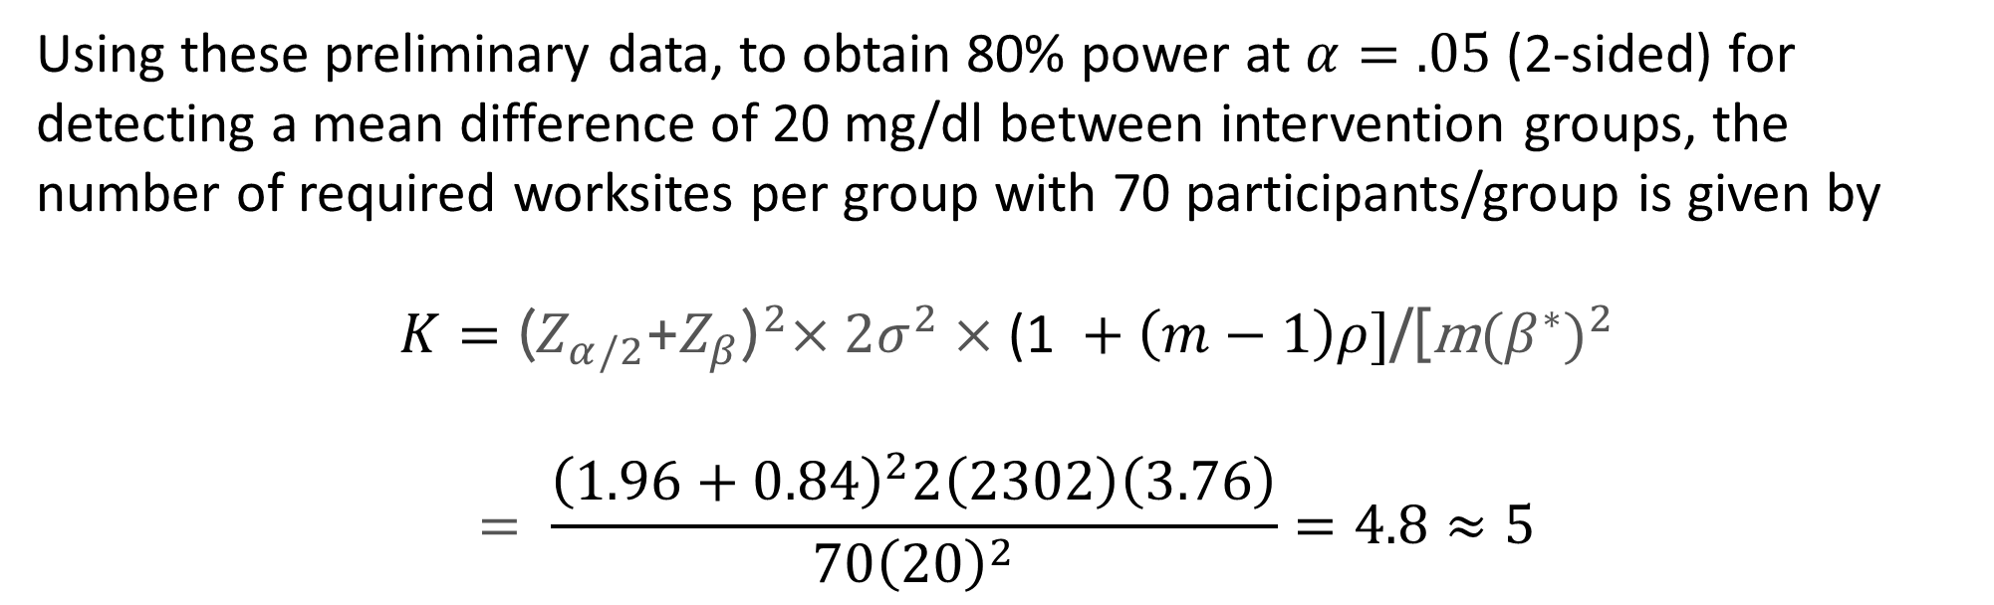
Using these preliminary data, to obtain 80% power at $α=.05$ (2-sided) for detecting a mean difference of 20 mg/dl between intervention groups, the number of required worksites per group with 70 participants/group is given by
$$K={\text{(}Z_{α/2}\text{+}Z_{β}\text{)}}^{2}×\text{2}σ^{2}×\text{(1} +\left(m−1\right)ρ]\text{/}\text{[}\text{m}{{(β}^{∗})}^{2}$$
$$= \frac{{\left(1.96+0.84\right)}^{2}2\left(2302\right)\left(3.76\right)}{70{\left(20\right)}^{2}}=4.8≈5$$

Slide 47
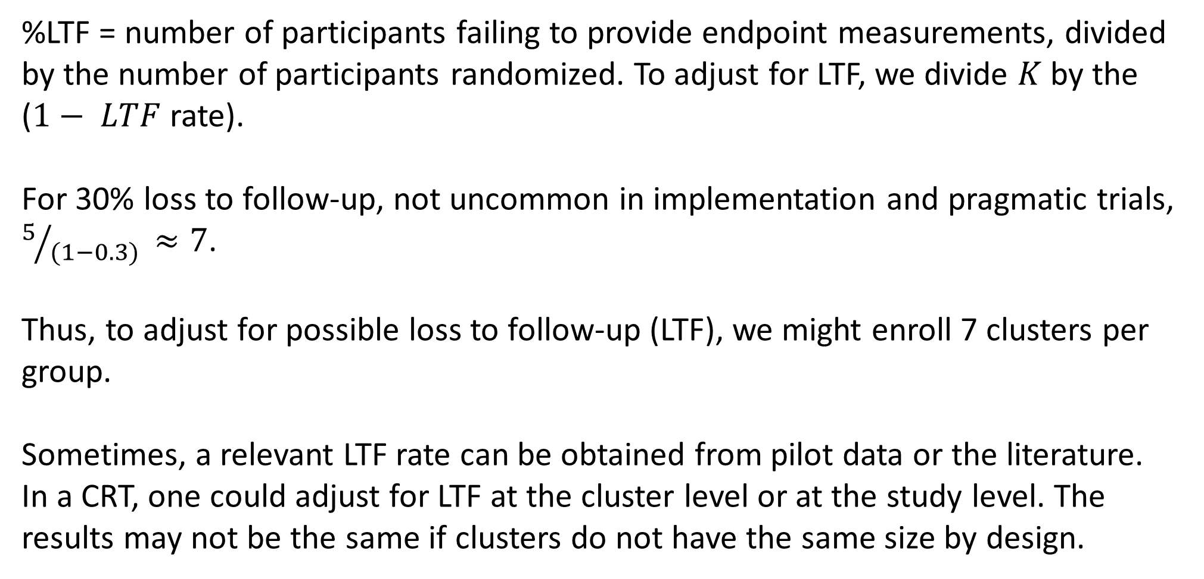
Adjusting study design for loss to follow-up
%LTF = number of participants failing to provide endpoint measurements, divided by the number of participants randomized. To adjust for LTF, we divide $K$ by the ($1− LTF$rate).
For 30% loss to follow-up, not uncommon in implementation and pragmatic trials, $5/{(1−0.3) }≈7$.
Thus, to adjust for possible loss to follow-up (LTF), we might enroll 7 clusters per group.
Sometimes, a relevant LTF rate can be obtained from pilot data or the literature. In a CRT, one could adjust for LTF at the cluster level or at the study level. The results may not be the same if clusters do not have the same size by design.

Slide 48
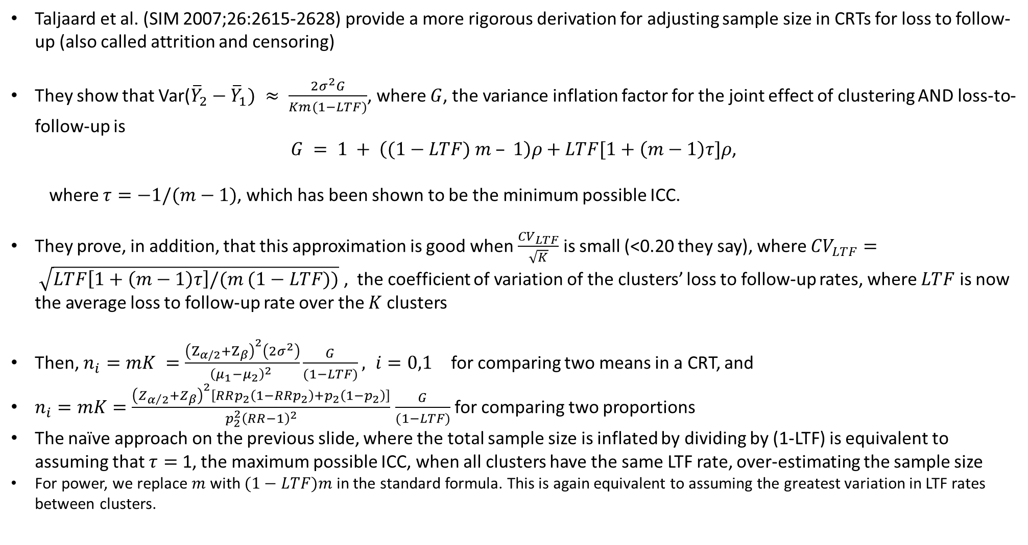
Adjusting for loss to follow-up
Taljaard et al. (SIM 2007;26:2615-2628) provide a more rigorous derivation for adjusting sample size in CRTs for loss to follow-up (also called attrition and censoring)
They show that Var(${\overline{Y}}_{2}−$ ${\overline{Y}}_{1}) ≈ \frac{2σ^{2}G}{Km(1−LTF)}$, where $G$, the variance inflation factor for the joint effect of clustering AND loss-to-follow-up is
$G = 1 + \left((1−LTF) m – 1\right)ρ+LTF[1+\left(m−1\right)τ]ρ$,
  where $τ=−1/(m−1)$, which has been shown to be the minimum possible ICC.
They prove, in addition, that this approximation is good when $\frac{{CV}_{LTF}}{\sqrt{K}}$ is small (<0.20 they say), where ${CV}_{LTF}= \sqrt{LTF\left[1+\left(m−1\right)τ\right]/(m (1−LTF))}$ , the coefficient of variation of the clusters’ loss to follow-up rates, where $LTF$ is now the average loss to follow-up rate over the $K$ clusters
Then, $n_{i}=mK =\frac{{\left(Ζ_{α/2}+Ζ_{β}\right)}^{2}\left(2σ^{2}\right)}{{\left(μ_{1}−μ_{2}\right)}^{2} }\frac{G}{(1−LTF)}, i=0,1$for comparing two means in a CRT, and
$n_{i}=mK=\frac{{\left(Z_{α/2}+Z_{β}\right)}^{2}\left[RRp_{2}\left(1−RRp_{2}\right)+p_{2}\left(1−p_{2}\right)\right]}{p_{2}^{2}{\left(RR−1\right)}^{2}}$ $\frac{G}{(1−LTF)}$ for comparing two proportions
The naïve approach on the previous slide, where the total sample size is inflated by dividing by (1-LTF) is equivalent to assuming that $τ=$ 1, the maximum possible ICC, when all clusters have the same LTF rate, over-estimating the sample size
For power, we replace $m$ with $(1−LTF)m$ in the standard formula. This is again equivalent to assuming the greatest variation in LTF rates between clusters.

Slide 49
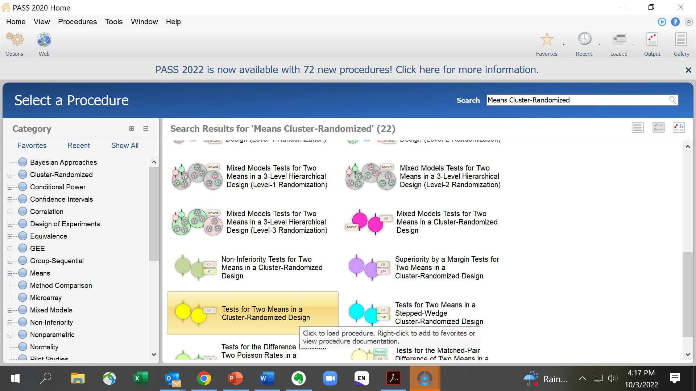
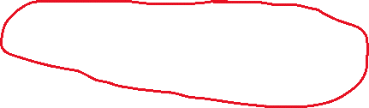

Slide 50
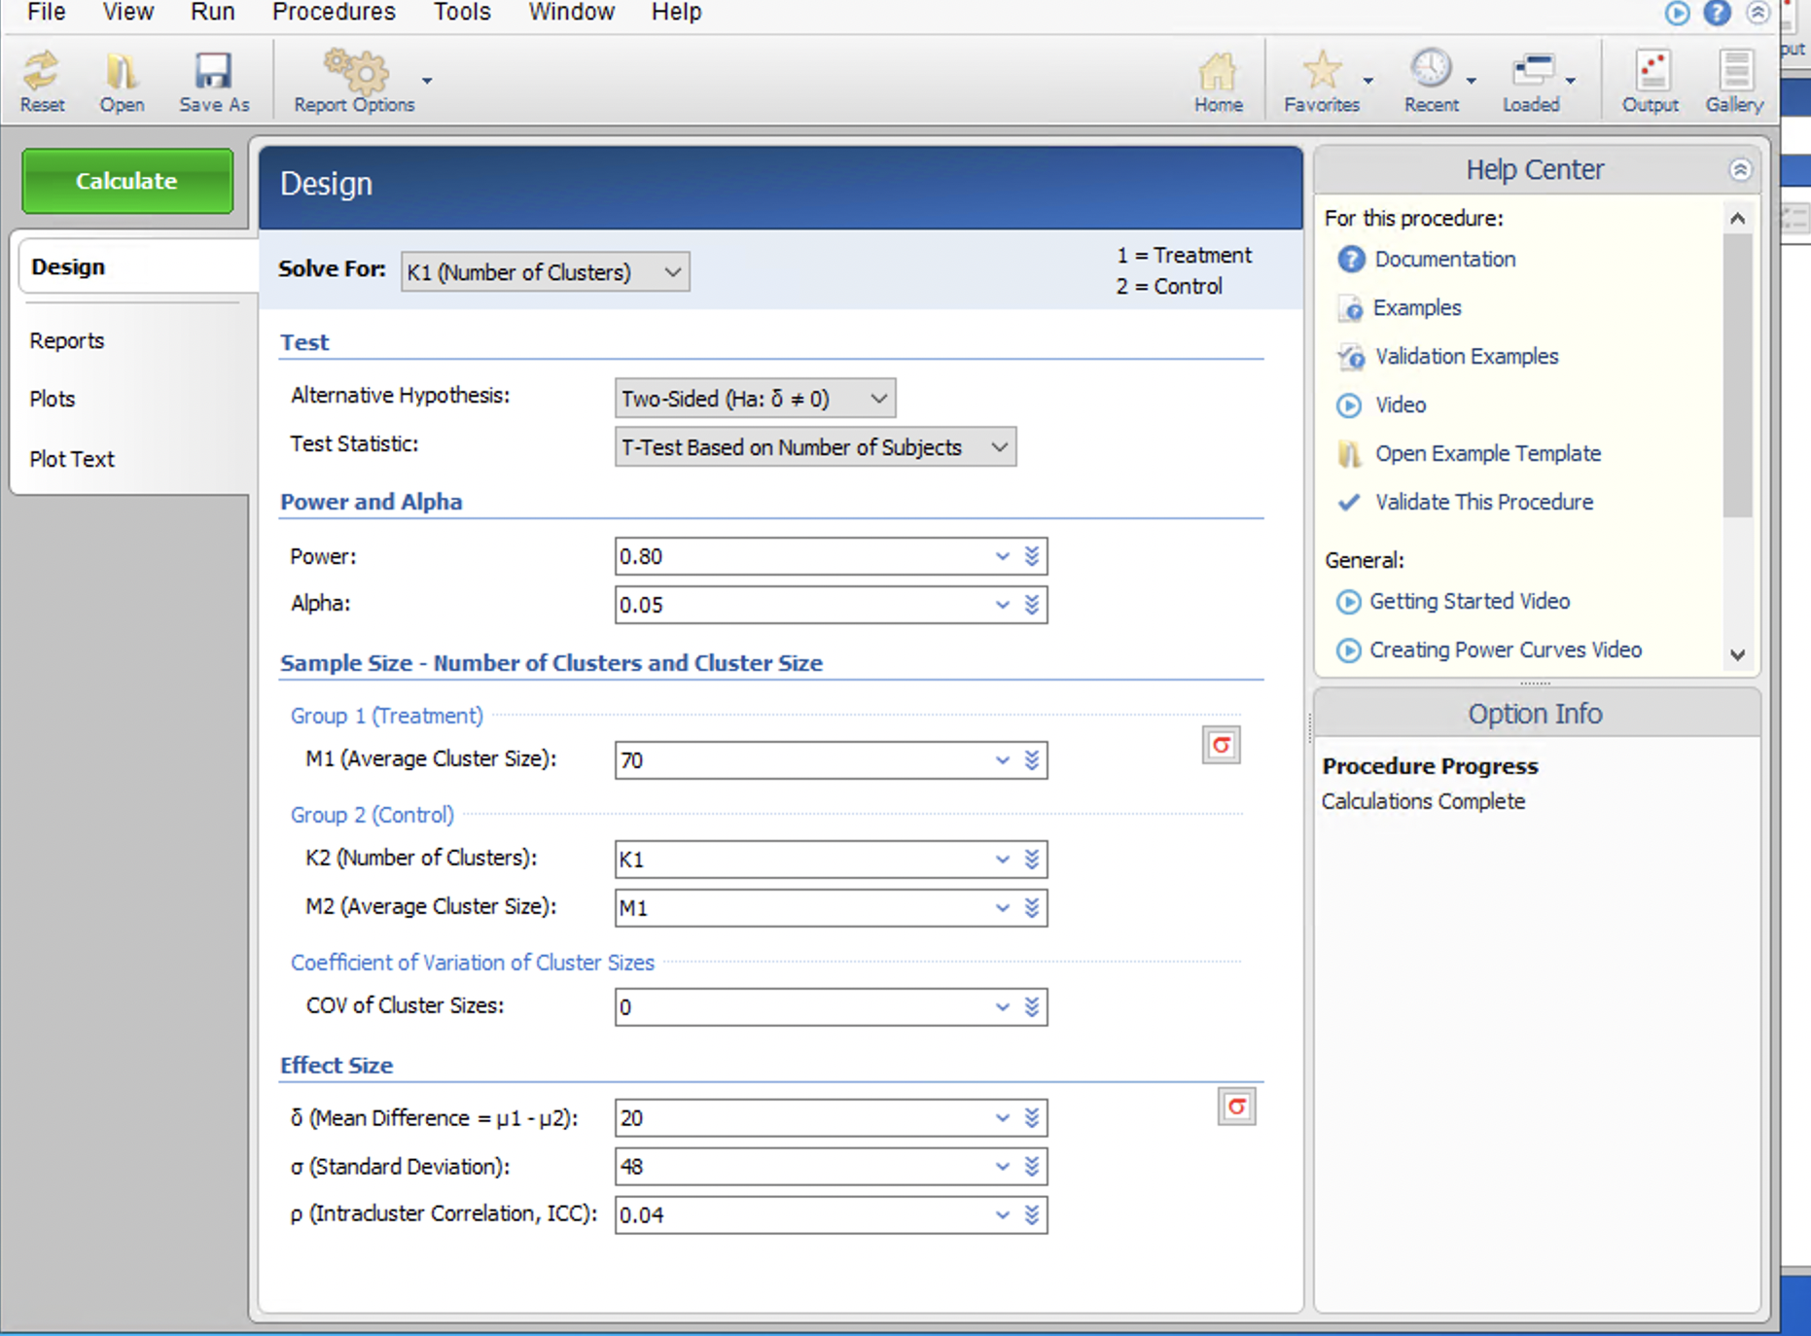

PASS Results
Standard Deviation = $\sqrt{2302}≈48$
Note: PASS denotes
intervention group with
subscript 1 and control group
with subscript 2, opposite of
course notes

Slide 51
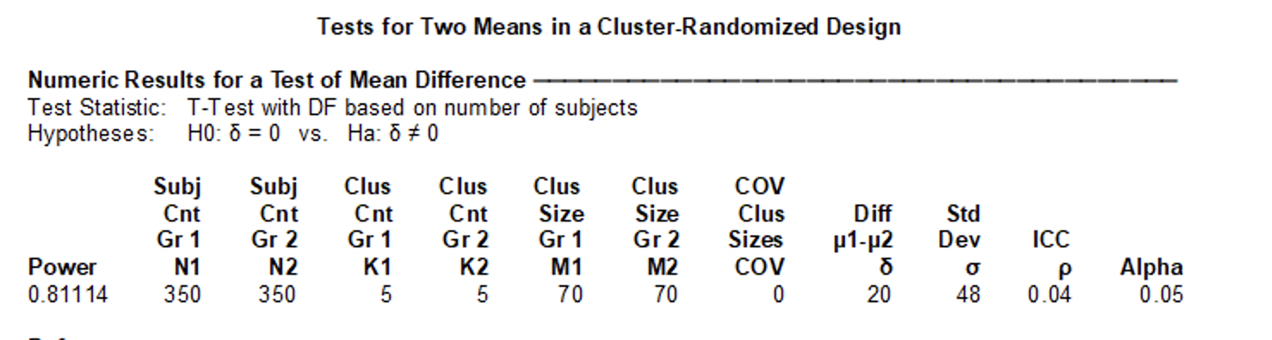

PASS Results

Slide 52
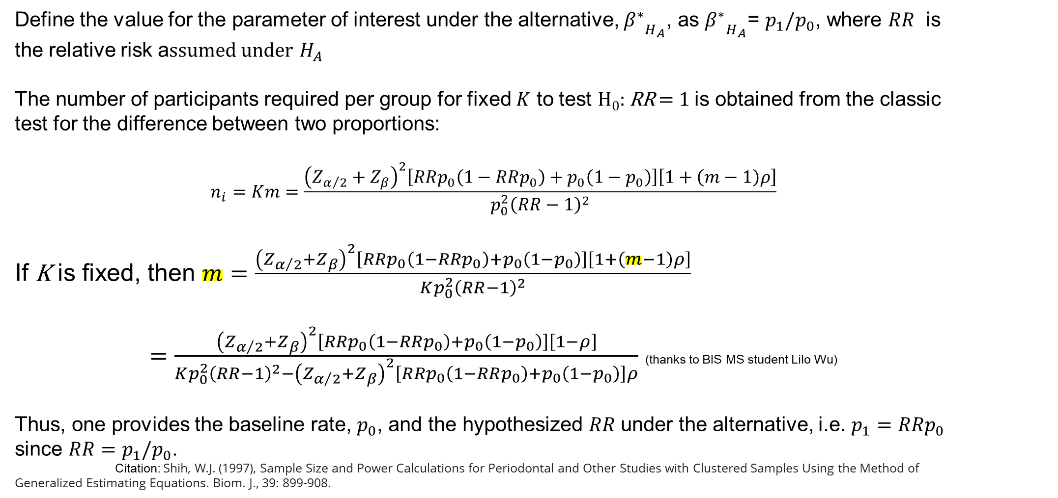
Sample size formula for the relative risk
Define the value for the parameter of interest under the alternative, ${β^{∗}}_{H_{A}}$, as ${β^{∗}}_{H_{A}}$= $p_{1}/p_{0}$, where $RR$ is the relative risk a$ssumed under$ $H_{A}$
The number of participants required per group for fixed $K$ to test H₀: RR = 1 is obtained from the classic test for the difference between two proportions:
$$n_{i}=Km=\frac{{\left(Z_{α/2}+Z_{β}\right)}^{2}\left[RRp_{0}\left(1−RRp_{0}\right)+p_{0}\left(1−p_{0}\right)\right]\left[1+\left(m−1\right)ρ\right]}{p_{0}^{2}{\left(RR−1\right)}^{2}}$$
If K is fixed, then $m=\frac{{\left(Z_{α/2}+Z_{β}\right)}^{2}\left[R{Rp}_{0}\left(1−RRp_{0}\right)+p_{0}\left(1−p_{0}\right)\right]\left[1+\left(m−1\right)ρ\right]}{Kp_{0}^{2}{\left(RR−1\right)}^{2}}$
$=\frac{{\left(Z_{α/2}+Z_{β}\right)}^{2}\left[R{Rp}_{0}\left(1−RRp_{0}\right)+p_{0}\left(1−p_{0}\right)\right]\left[1−ρ\right]}{Kp_{0}^{2}{\left(RR−1\right)}^{2}−{\left(Z_{α/2}+Z_{β}\right)}^{2}\left[R{Rp}_{0}\left(1−RRp_{0}\right)+p_{0}\left(1−p_{0}\right)\right]ρ}$ (thanks to BIS MS student Lilo Wu)
Thus, one provides the baseline rate, $p_{0}$, and the hypothesized $RR$ under the alternative, i.e. $p_{1}=RRp_{0}$ since $RR=p_{1}/p_{0}$.
Citation: Shih, W.J. (1997), Sample Size and Power Calculations for Periodontal and Other Studies with Clustered Samples Using the Method of Generalized Estimating Equations. Biom. J., 39: 899-908.

Slide 53
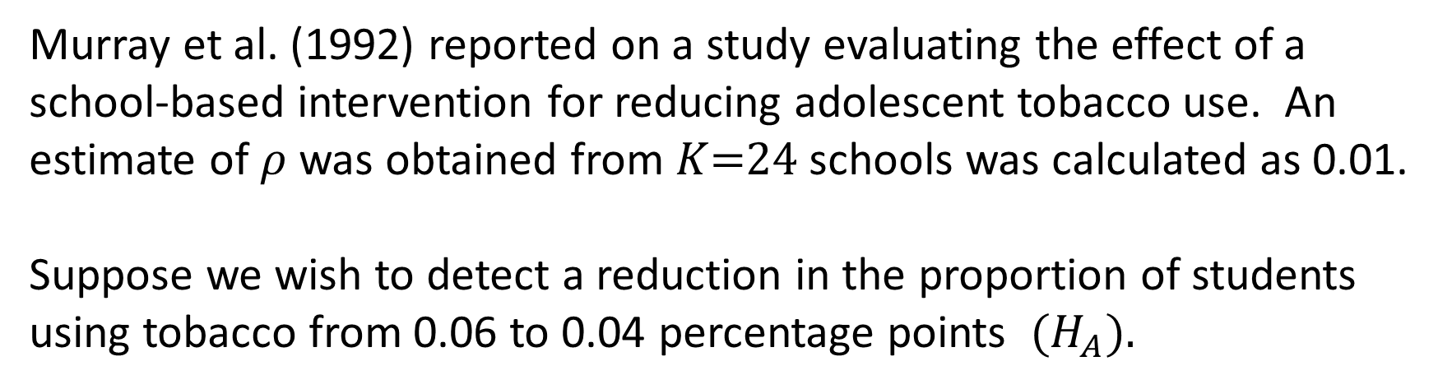
Example:
Murray et al. (1992) reported on a study evaluating the effect of a school-based intervention for reducing adolescent tobacco use. An estimate of $ρ$ was obtained from $K$=24 schools was calculated as 0.01.
Suppose we wish to detect a reduction in the proportion of students using tobacco from 0.06 to 0.04 percentage points $(H_{A}).$

Slide 54
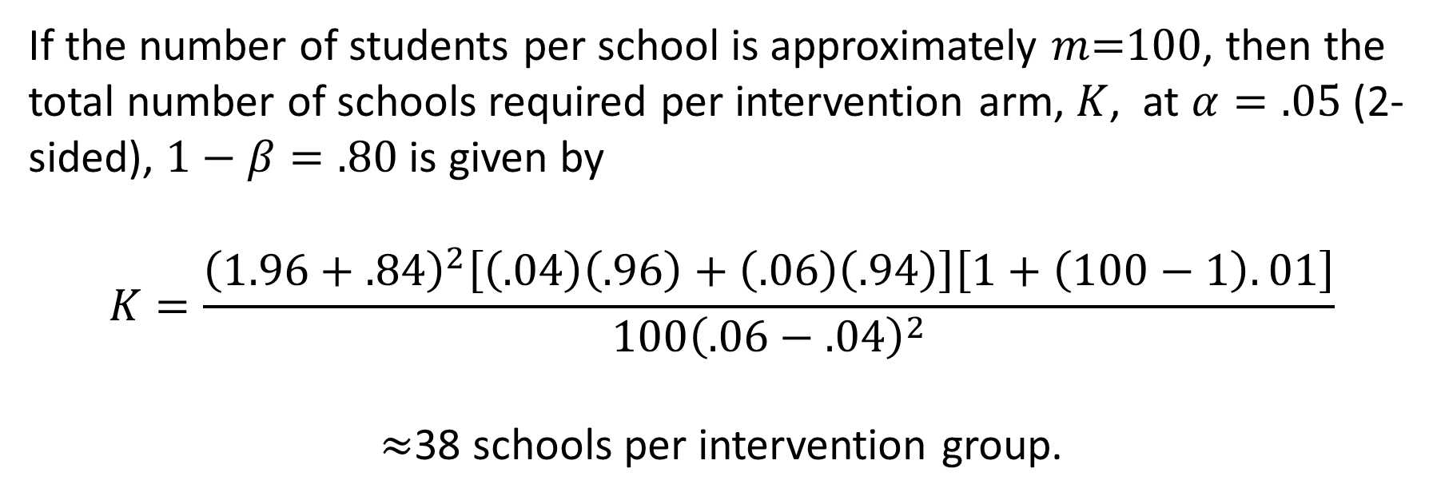
Example 2: (cont.)
If the number of students per school is approximately $m$=100, then the total number of schools required per intervention arm, $K$, at $α=.05$ (2-sided), $1−β=.80$ is given by
$$K=\frac{{\left(1.96+.84\right)}^{2}\left[\left(.04\right)\left(.96\right)+\left(.06\right)\left(.94\right)\right]\left[1+\left(100−1\right).01\right]}{{100\left(.06−.04\right)}^{2}}$$
$≈$38 schools per intervention group.

Slide 55
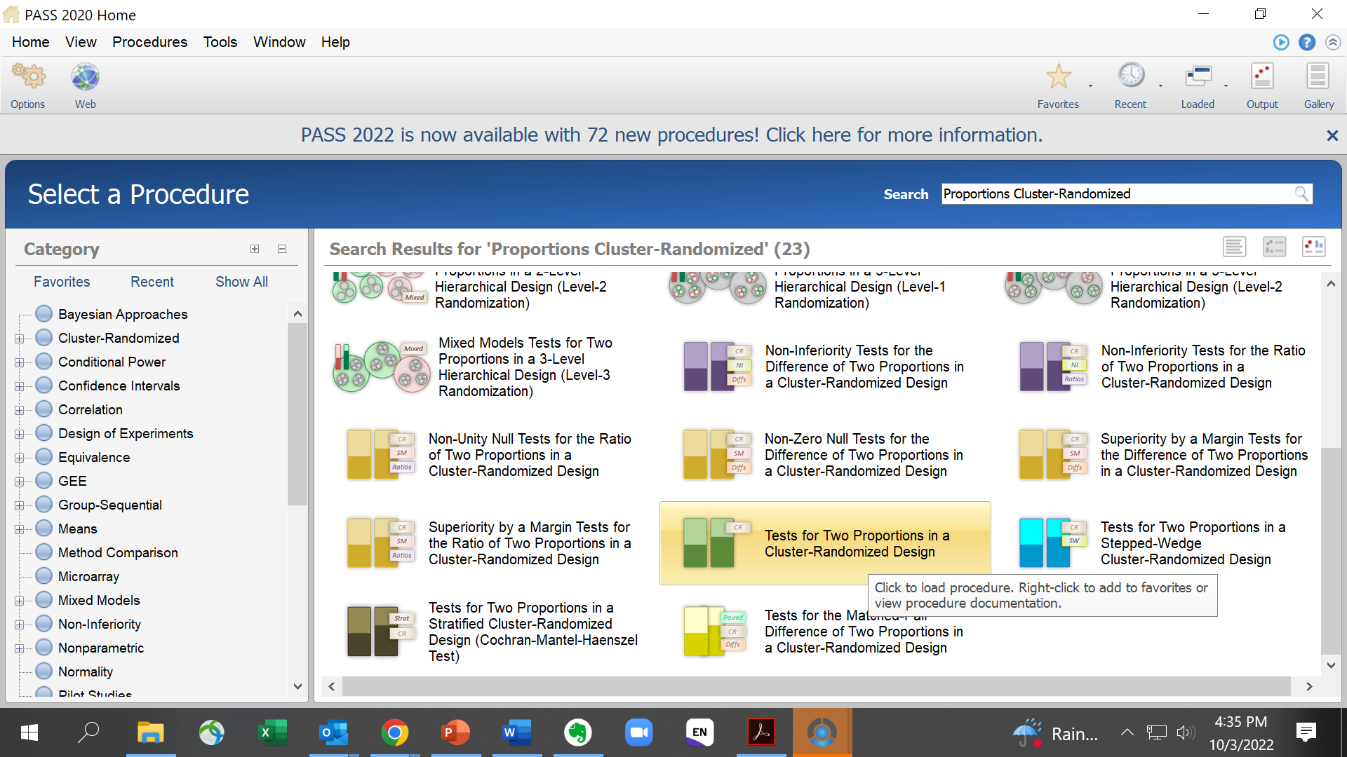
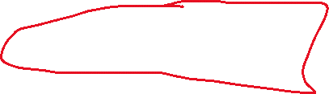

Slide 56
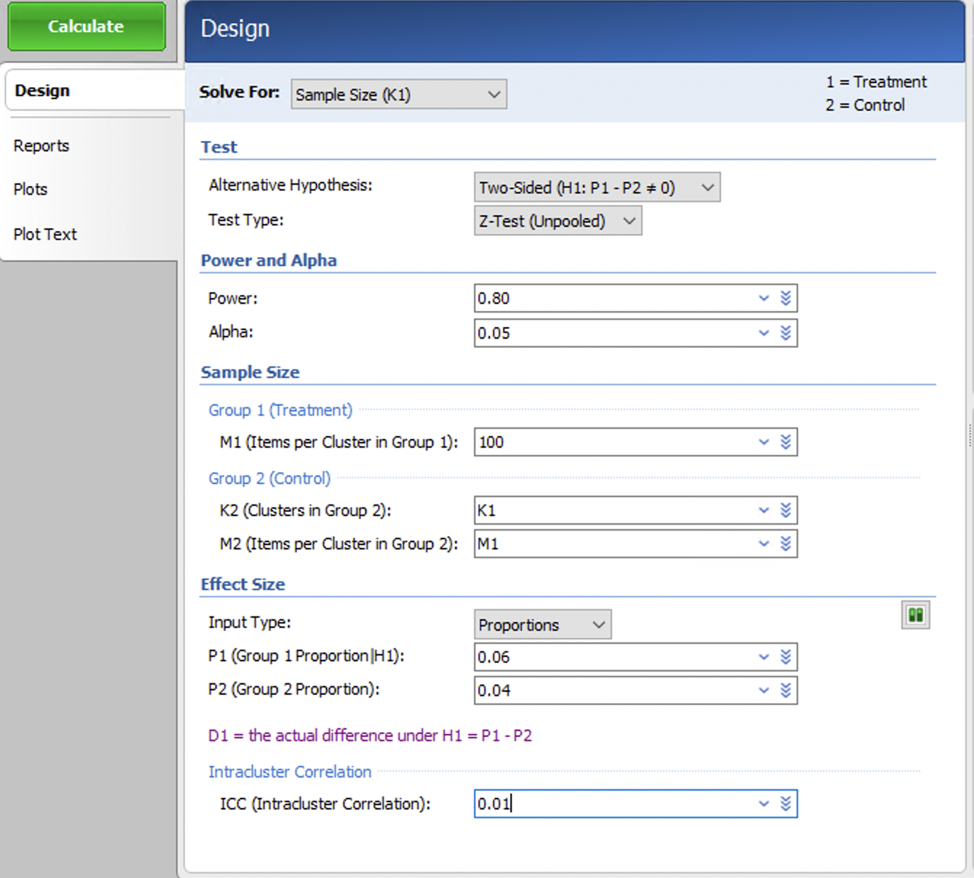
Example 2: (cont.)

Slide 57
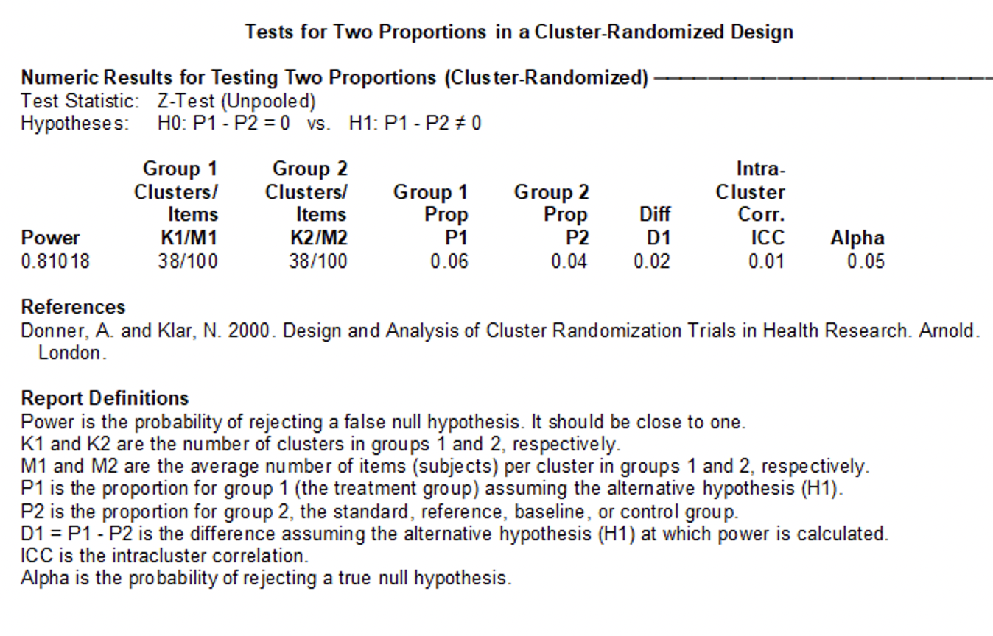
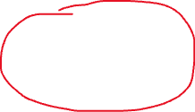
Example 2: (cont.)

Slide 58
Familia Salama:
Wards were randomized to one of four arms in this cluster-randomized 2x2 factorial implementation trial
60 wards
Community intervention:
36 wards
No community intervention:
24 wards
Option B: 22 wards
(36,540 pregnancies)
Option A: 14 wards (35,622 pregnancies)
Option B: 10 wards (44,424 pregnancies)
Option A: 14 wards
(37,098 pregnancies)
80,964 B vs. 77,720 A expected,
89,014 B vs. 98,419 A observed
72,162 CHW vs. 81,522 SOC expected
103,628 CHW vs. 83,805 SOC observed

Slide 59

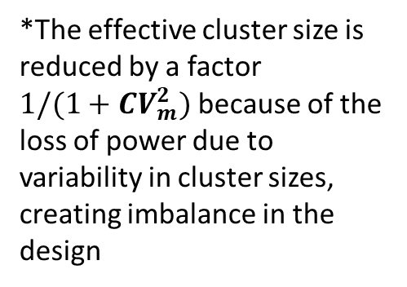
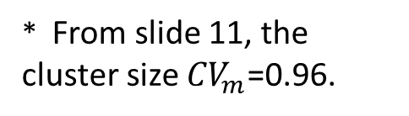
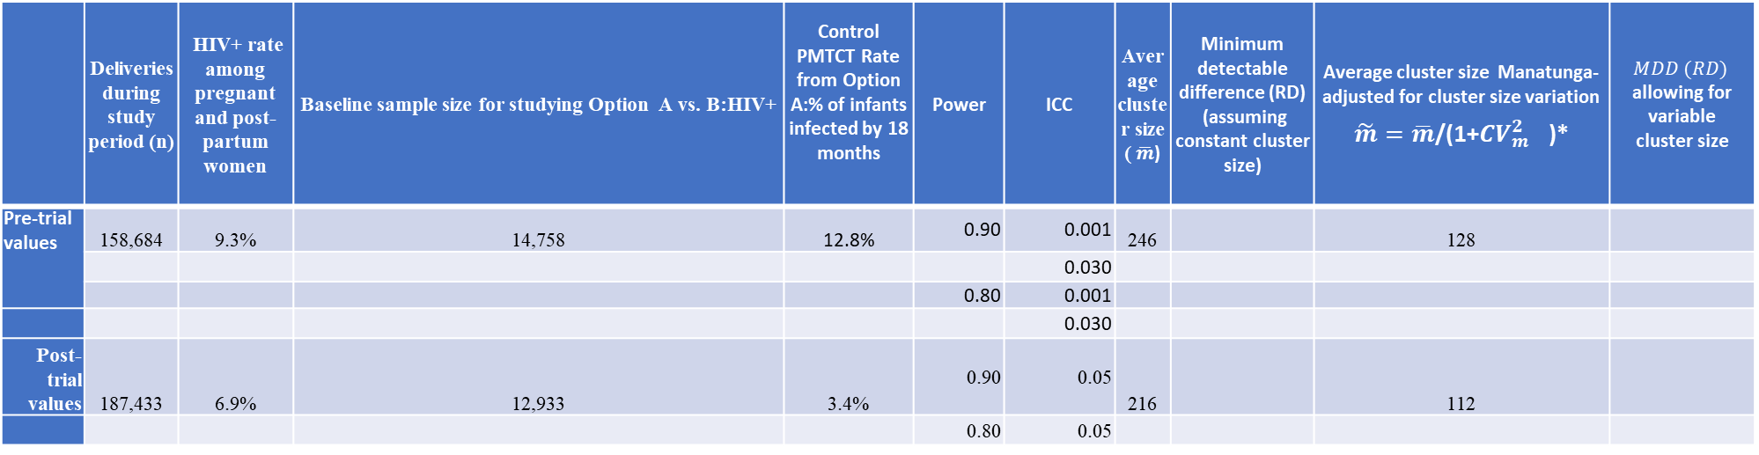
Let’s find the minimum detectable PMTCT rate difference ($RR$) comparing Option B to A, Familia Salama ($K_{1}$+ $K_{2}$=60)
 | Deliveries during study period (n) | HIV+ rate among pregnant and post-partum women | Baseline sample size for studying Option A vs. B:HIV+ | Control PMTCT Rate from Option A:% of infants infected by 18 months | Power | ICC | Average cluster size ( $\overline{m}$) | Minimum detectable difference (RD) (assuming constant cluster size) | Average cluster size Manatunga-adjusted for cluster size variation $\tilde{m}=\overline{m}$/(1+${{CV}_{m}^{2}}^{}$)* | $$MDD (RD)$$ allowing for variable cluster size
Pre-trial values | 158,684 | 9.3% | 14,758 | 12.8% | 0.90 | 0.001 | 246 |  | 128
 |  |  |  |  |  | 0.030
 |  |  |  |  | 0.80 | 0.001
 |  |  |  |  |  | 0.030
Post-trial values | 187,433 | 6.9% | 12,933 | 3.4% | 0.90 | 0.05 | 216 |  | 112
 |  |  |  |  | 0.80 | 0.05
Recall:
80,964 B vs. 77,720 A expected,
89,014 B vs. 98,419 A observed
Actual 18 month PMTCT rate in option A was 3.4%, and in option B, 2.3%! Baseline outcome rates used for pre-trial planning came from modeling paper for Zimbabwe (Ciaranello, 2011)
ICCs from Feldblum, 1999; Jokhio, 2005; Ukwuani, 2003.
* From slide 11, the cluster size ${CV}_{m}$=0.96.
  Pre-trial HIV prevalence in DSM Region: 9.3% among 15-49 year olds (2nd highest of any region in Tanzania)
  Actual: 5.1% at delivery, 6.0% at the first ANC visit, 6.9% at ANC according to national data 2010
*The effective cluster size is reduced by a factor
$1/(1+{CV}_{m}^{2})$because of the loss of power due to variability in cluster sizes, creating imbalance in the design

Slide 60


Minimum detectable PMTCT rate comparing Option A to B, Familia Salama
Endpoints | Control (Option A) | Power | ICC | Minimum detectable difference after adjusting cluster size
% of infants infected by 18 months | 3.4% | 0.80 | 0.05 | What is the value?
The minimum detectable effect (MDE) between two proportions $p_{1}−p_{0}=$ ${RR p}_{0}−p_{0}=p_{0}(RR−1)$ can be calculated by solving for $RR$ given $π\%$ power using the following formulation for $λ,$ based on the normal approximation to the binomial and the Wald test approach
$$λ(π)=\frac{{p_{0}^{2}{ (RR−1)}^{2}}^{}}{\left(\frac{{RR p}_{0}(1−{RR p}_{0})}{n_{2}}+\frac{p_{0}(1−p_{0})}{n_{1}}\right)IF}$$

Slide 61

Minimum detectable PMTCT rate in Option B, Familia Salama
In “Tests for Two Proportions in a Cluster-Randomized Design” module
Adjusted for variable cluster size using Manatunga method

Slide 62


Minimum detectable PMTCT rate in Option B, Familia Salama

Slide 63


Power for observed PMTCT rate in Option B, Familia Salama
Here, we show the power given by PASS for the observed difference (2.3% -3.4% =-1.1%) between the two rates
given $K$=30, $m$=12933/60=216, ICC of 0.05, where 12,933 is the average cluster size; not adjusted for variable cluster size
You can only see the effect for the elimination of the

Slide 64




Power for observed PMTCT rate in Option B, Familia Salama
Here we show how to calculate the power for observed difference between the two rates allowing for variable clusters per arm and variable cluster size per arm. PASS does not allow for variable cluster size within arm – the formula on slide 35-36 should be used, with $\tilde{m}=\overline{m}$/(1+${CV}_{m}^{2}$)
$From slide 54, K_{1}=32$, $K_{2}=28$, ${\overline{m}}_{1}$=$n_{1}$*HIV_rate /$K_{1}$
= 89,014*0.069/32 = 192
$${\tilde{m}}_{1}=\frac{192}{1+{0.96}^{2}}=99.9$$
${\overline{m}}_{2}$= 98,419*0.069/28=243
$${\tilde{m}}_{2}=\frac{243}{1+{0.96}^{2}}=126.5$$
Power is 0.183

Slide 65

Minimum detectable PMTCT rate in Option B, Familia Salama
 | Deliveries during study period (n) | HIV+ rate among pregnant and post-partum women | Baseline sample size for studying Option A vs. B:HIV+ | Control PMTCT Rate from Option A:% of infants infected by 18 months | Power | ICC | Average cluster size ( $\overline{m}$) | Minimum detectable difference (RR) (assuming constant cluster size) | Average cluster size adjusted for cluster size variation $\tilde{m}=\overline{m}$/(1+${CV}_{m}^{2}$)* | MDE (RR) allowing for variable cluster size
Pre-trial | 158,684 | 9.3% | 14,758 | 12.8% | 0.90 | 0.001 | 246 | -0.019(0.85) | 128 | -0.025(0.80)
 |  |  |  |  |  | 0.030 |  | -0.047(0.63) |  | -0.049(0.62)
 |  |  |  |  | 0.80 | 0.001 |  | -0.017(0.87) |  | -0.022(0.83)
 |  |  |  |  |  | 0.030 |  | -0.041(0.68) |  | -0.043(0.66)
Post-trial | 187,433 | 6.9% | 12,933 | 3.4% | 0.90 | 0.05 | 216 | -0.027(0.21) | 112 | -0.028(0.18)
 |  |  |  |  | 0.80 | 0.05 |  | -0.025(0.26) |  | -0.025(0.26)
Variable cluster size requires a larger |MDE| than constant cluster size
Larger ICCs require larger |MDE|
Greater required power increases the |MDE|

Slide 66
MATCHED PAIR CRT
Example:
The COMMIT community intervention trial was designed to promote smoking cessation using a variety of community resources. The primary outcome measure was the 5-year smoking cessation rate.
Unit of Randomization: Community
Number of Matched Pairs: 11

Slide 67
MATCHED PAIR CRT (cont.)
Matching Variables: | Community size, population density, demographic profile, community structure, geographical proximity
COMMIT Research Group (1995)

Slide 68
Benefits of Matching
If an effective matching factor can be found, the matched design is more powerful than the corresponding completely randomized design.
Failure to match may lead to a poor randomization, particularly with smaller numbers of clusters, thus undermining a trial’s validity, due to random imbalances of outcome risk factors by group. (See slides 13-14)

Slide 69
Evaluation of the Effectiveness of Matching
There has been considerable research comparing the power of completely randomized and matched pair designs, (e.g., Martin et al. [1993], Klar and Donner [1997]). Some findings from this research are as follows:
If the total study size is 20 or fewer clusters (10 treated and 10 control) then matching should be used only if the investigators are confident that the correlation of outcomes within matched pairs is at least 0.20.
“It is unlikely that effective matching would be possible for small studies. Matching may be overused as a design tool”.

Slide 70


COMMIT TRIAL – how to estimate the matching correlation (post-hoc!)
 | Proportion of Heavy Smokers Who Quit
Community Pair $j$ | Experimental ${\hat{p}}_{1j}$ | Control ${\hat{p}}_{0j}$
1 2 3 4 5 6 7 8 9 10 11 | 0.139 0.163 0.164 0.204 0.183 0.164 0.262 0.193 0.215 0.136 0.155 | 0.205 0.202 0.163 0.249 0.16 0.186 0.23 0.169 0.127 0.172 0.189
$${\hat{ρ}}_{Μ}=\text{Corr}\left({\hat{p}}_{1j},{\hat{p}}_{0j}\right)=0.21$$

Slide 71

Sample Size Estimation for Matched Pair Designs
A simple strategy is to multiply the required number of clusters or required number of participants per cluster obtained from the previous formulas for a completely randomized design by ${1−ρ}_{M}$, where $ρ_{M}$ denotes the anticipated value of the matching correlation.
If $ρ_{M}$ >0, as would typically be the case, then ignoring the matching for sample size estimation is conservative.

Slide 72

Examples of estimated matching correlations
Source | Unit of Randomization | Number of Pairs | Outcome Variable | Matching Correlation $(ρ_{M}$)
Stanton & Clemens (1987) | Cluster of Families | 25 | Childhood Diarrhea Rate | 0.49
Kidane & Morrow (2002) | Cluster of villages | 12 | Childhood Mortality | -0.39
Thompson et al. (1997) | Physician Practice | 13 | Levels of Coronary Risk Factors | 0.13
Ray et al. (1997) | Nursing Home | 7 | Rate of Recurrent Falling | 0.63
Peterson et al (2002) | School district | 20 | Prevalence of Smoking | 0.34
Haggerty et al. (1994) | Community | 9 | Childhood Diarrhea Rate | -0.32
Grosskurth et al. (1995) | Community | 6 | HIV Rate | 0.94
The COMMIT Research Group (1995) | Community | 11 | Smoking Quit Rate | 0.21

Slide 73

Should CRTs be pair matched?
Donner’s view is that that matching should be used cautiously in cluster randomization trials, particularly if the total number of matched pairs is small or if the matching correlation is low (<0.2)
In pair-matched cluster randomized designs, the effect of the intervention is confounded with the natural variation between the clusters within each matched pair. The intra-cluster correlation $ρ$ cannot be estimated without imposing an assumption of common intervention effect across matched pairs. In my view, this is a reasonable assumption.
Note: Imai and King adamantly disagree and strongly advocate for matched pair CRTs (Stat Sci, 2007)

Slide 74
STRATIFIED CRT
Example:
To evaluate the effectiveness of treated nasal tissues versus placebo tissues in reducing incidence of respiratory illness at 24 weeks.
Unit of Randomization: Family
Number of Strata: 3
Number of Clusters per Stratum: 30
Stratification Variable: Family size (2, 3, or 4 members)
Farr et al. (1988)

Slide 75

Features of the Stratified Design
Provides some control in the design on factors known to be related to outcome. Imbalances on remaining variables can be adjusted for statistically.
Permits an estimate of $ρ$ to be computed without the need to assume homogeneity of intervention effects

Slide 76
Examples:
Study Purpose:
The purpose of the WHO antenatal trial was to compare the impact of two programs of antenatal care on the health of mothers and newborns.
Unit of Randomization: Antenatal care clinic

Slide 77
Examples: (cont.)
Stratification Variables: | Primary stratification was by country: Thailand, Cuba, Argentina, Saudi Arabia.
Number of Clusters per Stratum: | Ranged from 12 to 17.
Villar et al. (2001)

Slide 78

Features of Stratified and Matched Pair CRTs
Decreasing the number of strata while increasing the number of clusters per stratum tends to reduce the closeness of the matching but increases the power to estimate $σ_{B}^{2}$ and $σ_{W}^{2}$, and hence the ICC.
When the number of pairs is fairly large (>20) in a matched pair design, it may be difficult to create matches that represent distinct rather than similar levels of risk across all strata. In this case, stratification with two or more clusters assigned to each treatment within strata may be preferable.
Notes:
Should elaborate on the second point – illustrate with an example

Slide 79
Analysis Strategies for CRTs

Slide 80
Conducting Cluster Level Analyses when Data are Available at the Individual Level
A method of simplifying the analysis is to collapse the data in each cluster, followed by construction of a meaningful summary measure to serve as the unit of analysis, e.g. the difference of the means in the two intervention groups.
Standard statistical methods, such as t-tests or permutation tests, can then be directly applied to the collapsed measures.
Given sufficient cluster sizes, the problem of non-independence is removed since subsequent significance tests and confidence intervals are based on variation between cluster summary values rather than on variation between individuals.

Slide 81

Cluster level analysis for means
The standard $χ^{2}$ test for the difference between two sample means takes the form
$Z^{2}=\frac{({\sum_{k=1}^{K}{w_{1k}}{\overline{Y}}_{1k}−\sum_{k=1}^{K}{w_{0k}{\overline{Y}}_{0k}})}^{2}}{\sum_{i=1}^{2}{\sum_{k=1}^{K}{Var(w_{ik}{\overline{Y}}_{ik})}}}\sim χ_{1}^{2}$ under $H_{0}$,
where ${\overline{Y}}_{ik}$ is the mean of cluster $k$ in group $i$, and $w_{ik}=\frac{{1/σ}_{ik}^{2}}{\sum_{k=1}^{K}{{1/σ}_{ik}^{2}}}$, where $σ_{ik}^{2}=Var\left({\overline{Y}}_{ik}\right)$
If $K$ is small, as is often the case, a more accurate finite sample p-value can be obtained by using the two-sided t-test instead, where under $H_{0}$ ,
$$\frac{|\sum_{k=1}^{K}{w_{1k}}{\overline{Y}}_{1k}−\sum_{k=1}^{K}{w_{0k}{\overline{Y}}_{0k}}|}{{Var}^{1/2}(\sum_{i=1}^{2}{\sum_{k=1}^{K}{w_{ik}{\overline{Y}}_{ik})}}}\sim t_{2(K−1)}$$

Slide 82

Cluster level analysis for means
Let ${\overline{Y}}_{ik}$ denote the outcome mean in the $k$th cluster in group $i$. Let $σ_{ik}^{2}=Var({\overline{Y}}_{ik})$.
Similar to the derivation on slide 27 for $Var({\overline{Y}}_{i})$, under the standard linear mixed model,
$$Y_{ijk}=β_{0}+β^{∗}X_{ijk}+b_{ik}+e_{ijk},$$
it can be shown that
$$σ_{ik}^{2}=Var\left({\overline{Y}}_{ik}\right)\text{=}\frac{σ^{2}}{m_{ik}}[1+ρ(m_{ik}−1)]$$
where $m_{ik}$ is the size of the ${ik}^{th}$ cluster.
Then, we estimate the intervention effect by ${\hat{β}}^{∗}=\sum_{k=1}^{K}{w_{1k}}{\overline{Y}}_{1k}−\sum_{k=1}^{K}{w_{0k}}{\overline{Y}}_{0k}$, where by generalized
least squares theory, we will now show that, although a consistent estimate is obtained from any choice
of weights that sum to 1, $w_{ik}=\frac{{1/σ}_{ik}^{2}}{\sum_{k=1}^{K}{{1/σ}_{ik}^{2}}}, i=0,1, k=1,…,K$ are the minimum variance weights among all possible choices.

Slide 83

Cluster level analysis for means
The main takeaway here is that
Here we use Lagrange multipliers to prove that inverse variance weighted average is most efficient estimator of the intervention effect
  $Var\left({\hat{β}}^{∗}\right)=Var\left(\sum_{k=1}^{K}{w_{1k}}{\overline{Y}}_{1k}−\sum_{k=1}^{K}{w_{0k}}{\overline{Y}}_{0k}\right)$ = $Var\left(\sum_{k=1}^{K}{w_{1k}}{\overline{Y}}_{1k}\right)+Var\left(\sum_{k=1}^{K}{w_{0k}}{\overline{Y}}_{0k}\right)={\sum_{k=1}^{K}{w_{1k}^{2}}σ}_{1k}^{2}+{\sum_{k=1}^{K}{w_{0k}^{2}}σ}_{0k}^{2}$,
  with
  $\sum_{k}{w_{1k}=1}$ and $\sum_{k}{w_{0k}=1}$
Then using Lagrange multipliers $λ_{1}$and $λ_{2}$to express the constraints, we write the variance as
  $Var({\hat{β}}^{∗})={\sum_{k=1}^{K}{w_{1k}^{2}}σ}_{1k}^{2}+{\sum_{k=1}^{K}{w_{0k}^{2}}σ}_{0k}^{2}+λ_{1}(\sum_{k}{w_{1k}−1})$+$λ_{2}(\sum_{k}{w_{0k}−1})$,
  and minimize this by solving
  $0=\frac{∂}{∂w_{ik}}$ $Var\left({\hat{β}}^{∗}\right)=2w_{ik}σ_{ik}^{2}−λ_{i},$ which implies that $w_{ik}$=$\frac{λ_{i}/2}{σ_{ik}^{2}}$
The main takeaway is that $w_{ik}∝\frac{1}{σ_{ik}^{2}}.$ Since $\sum_{k}{w_{ik}=1}$,
$\sum_{k=1}^{K}{\frac{λ_{i}/2}{σ_{ik}^{2}}=1}⇒$ ($λ_{i}/2)\sum_{k=1}^{K}{\frac{1}{σ_{ik}^{2}}}$ = 1 $⇒$ $\frac{2}{λ_{i}}=\sum_{k}{1/σ_{ik}^{2}}$.
Thus, $w_{ik}=\frac{1}{σ_{ik}^{2}}{(\sum_{k}{1/σ_{ik}^{2}})}^{−1}$, i=0,1

Slide 84

Cluster level analysis for means
Thus, for this optimal choice of weights, where optimality is defined as minimizing variance,
$$Var\left(\sum_{k=1}^{K}{w_{1k}}{\overline{Y}}_{1k}−\sum_{k=1}^{K}{w_{0k}}{\overline{Y}}_{0k}\right)=\frac{1}{{\sum_{k=1}^{K_{1}}{{1/σ}_{1k}^{2}}}^{}} +\frac{1}{{\sum_{k=1}^{K_{2}}{{1/σ}_{0k}^{2}}}^{}}$$
If $σ_{ik}^{2}=\frac{σ^{2}}{m_{ik}}[1+ρ(m_{ik}−1)], ∀i,k,$ and $m_{ik}=m$, $∀i$, $k$ the above formula simplifies to
$Var\left(\sum_{k=1}^{K}{w_{1k}}{\overline{Y}}_{1k}−\sum_{k=1}^{K}{w_{0k}}{\overline{Y}}_{0k}\right)=2\frac{σ^{2}[1+ρ(m−1)]}{Km}$ , same as in individual-level analysis!
We also have $σ_{ik}^{2}=\frac{σ_{W}^{2}}{m}+σ_{B}^{2}$= $\frac{σ_{W}^{2}}{m}$+ $\frac{σ_{W}^{2}ρ}{1−ρ}$.
Hence, a valid and efficient analysis in a CRT can be conducting by estimating each cluster’s mean, the within-cluster variance, $σ_{W, ik}^{2}$and $ρ$.
With a continuous outcome, $σ_{ik}^{2}$ can be estimated in each cluster by knowledge of the cluster size, and estimates of $ρ$ and $σ^{2}$.
Clusters can be sampled to obtain the within cluster mean and variance estimates, that is, not all $m_{ik}$participants need to be measured. (rapid implementation science)

Slide 85

Cluster level analysis for proportions
By substituting ${\hat{p}}_{ik}$ for ${\overline{Y}}_{ik},$ where $Var\left({\hat{p}}_{ik}\right)≈\frac{p_{ik}(1−p_{ik}) [1+ρ(m−1)]}{m}$ = $σ_{ik}^{2}$
The denominator of the cluster-level test statistic for the difference between two proportions, with the risk difference as the parameter of interest, is
$Var(\sum_{k=1}^{K}{w_{1k}}{\hat{p}}_{1k}−\sum_{k=1}^{K}{w_{0k}}{\hat{p}}_{0k})$ =${\left[\frac{1}{\sum_{k=1}^{K}{{1/σ}_{1k}^{2}}}\right]}^{}$+ ${\left[\frac{1}{\sum_{k=1}^{K}{{1/σ}_{0k}^{2}}}\right]}^{}$
$$≈\frac{{[p}_{0}\left(1−p_{0}\right)+p_{1}\left(1−p_{1}\right)][1+ρ(m−1)]}{Km}$$
(Donner, 1981)
The same test statistics can be used as above (slide 81).

Slide 86

Cluster level analysis: Selection of weights when cluster size varies
When appropriately weighted, cluster-level analyses provide inferences which are equivalent to individual-level analyses even in the presence of variable cluster sizes.
From slide 34, If $σ_{ik}^{2}=\frac{σ^{2}}{m_{ik}}[1+ρ(m_{ik}−1)], ∀i,k,$ and $m_{ik}=m$, $∀i$, $k$ the variance of the outcome in each cluster is constant across all clusters over both intervention groups, and the above formula simplifies to
$Var\left(\sum_{k=1}^{K}{w_{1k}}{\overline{Y}}_{1k}−\sum_{k=1}^{K}{w_{2k}}{\overline{Y}}_{2k}\right)=2\frac{σ^{2}[1+ρ(m−1)]}{Km}$ , same as in individual-level analysis!
Calculation of the optimal weights requires knowledge or estimation of $ρ$
When there are few clusters per intervention group, estimates of $ρ$ will be imprecise
Consequently, the use of weights may result in a loss of finite sample size power and could even compromise validity of statistical inference in finite samples (e.g., Gumpertz and Pantula, 1989).

Slide 87

Equivalence of cluster-level and individual-level analysis
Investigators have occasionally claimed that cluster level analyses will only provide valid statistical inferences when the intra-cluster correlation coefficient $ρ$=1
  This is incorrect.
For balanced designs with homoscedastic outcomes, unweighted cluster level analyses provide inferences which are equivalent to those obtained using a mixed linear regression model for any value of $ρ$ (Koepsell, 1981). Balanced design here means all clusters have the same size and there are the same numbers of clusters in each group. (not the case for HPTN)
Otherwise, the unweighted cluster level analysis remains unbiased/consistent, but is inefficient. An interesting research question is how inefficient for small departures from balance? From normality of residuals in the case of continuous data using the model-based variance rather than the robust variance?

Slide 88

The Benefits of Balance (cont.)
Consider a CRT with $K$ clusters in each of two intervention groups with $m$participants per cluster and a homoscedastic outcome.
A test for the effect of intervention can be constructed using either
  A two sample t-test with $2(K−1)$degrees of freedom calculated using the unweighted means as a summary score for each cluster.
  A mixed effects linear regression model.
The resulting test statistics are identical (Koepsell et al. [1991]).

Slide 89
The Benefits of Balance for Cluster-level Analysis
To repeat, an important special case arises in trials having a homoscedastic quantitative outcome variable when each cluster has a fixed number of participants (i.e., balanced design).
Unweighted cluster-level analyses are then fully efficient, as well as being unbiased/consistent.

Slide 90

Conducting an Individual Level Analysis of a CRT using Mixed Effects Regression: continuous outcome
Let the study outcome be denoted by $Y_{ikj}$ for the $j^{th}$ subject, j=1,..., $m_{ik}$, in the $k$^{th} cluster, in the $i^{th}$ intervention group, $i=0,1.$
Consider the mixed effects linear regression model given by
$Y_{ikj}=β_{0}+β^{∗}Χ_{ikj}+b_{ik}+ε_{ikj}$
where
$$Χ_{ikj}=\left\{\begin{matrix}0 if i=0\left(\text{control}\right) \\ \begin{aligned}\text{1 } if i=1\left(\text{interventio}\text{n}\right) \\ \end{aligned}\end{matrix}\right.$$
$$b_{ik}\sim Ν\left(0,σ_{B}^{2}\right) and ε_{ikj}\sim Ν\left(0,σ_{W}^{2}\right)$$

Slide 91

The fixed effects are ${ β}_{0}=\text{intercept} \text{and} β^{∗}=\text{intervention} \text{effect}$
The random effects are $b_{ik}\sim Ν\left(0,σ_{B}^{2}\right)$ and $ε_{ikj}\sim Ν\left(0,σ_{W}^{2}\right)$ giving
$$ρ=\frac{σ_{B}^{2}}{σ_{B}^{2}+σ_{W}^{2}}$$
The random effects $b_{ik}$ and $ε_{ikj}$ are assumed to be independent, except for $b_{ik}$ within the same cluster, as assumed previously.
Estimation and inference may be obtained using procedure PROC MIXED or PROC GENMOD, GEE in SAS.
Or using glmer() in lme4 package in R.

Slide 92

Relationship between Mixed Effects Linear Regression and Multilevel Modelling
The mixed effects linear regression model can also be expressed as a multilevel model:
$Y_{ikj}=β_{0_{ik}}+{β^{∗}}_{ik}Χ_{ikj}+ε_{ikj}, i=0,1;k=1,K$ (Level 1)
Run a regression within each cluster k, k=1,…,K, to get an estimate of ${\hat{β}}_{1ik}$
${{\hat{β}}^{∗}}_{ik}={β^{∗}}_{ik}+b_{ik}$ + $ε_{ik}$ (Level 2)
Run a regression on the 2K ${{\hat{β}}^{∗}}_{ik},$ weighted by the inverse of $Var\left({{\hat{β}}^{∗}}_{ik}\right),$ to obtain a common estimate, ${\hat{β}}^{∗}$.
Note: This approach is not an option for CRTs because $Χ$ is the same for all participants in a given cluster! Is an option for SWDs though.

Slide 93
Multi-level and mixed regression analysis will provide identical results even with individually randomized and stepped wedge unbalanced designs where cluster sizes are variable.
In addition, a properly weighted cluster-level analysis will also provide identical inferences. Proper weights are based upon the inverse of the variance of each cluster-level mean, and incorporate heteroscedasticity and variable cluster size.
Other terms used for multilevel models are “random-coefficient” models and “hierarchical” models

Slide 94

Generalized Estimating Equations Approach
The normality assumptions of the mixed effects linear regression model may be avoided by using the robust variance estimation procedure popularized by Liang and Zeger (1986).
For a balanced design, a robust test of the effect of intervention on the cluster level is given by the two sample t-test statistic inflated by a factor of
$$\sqrt{2K/\left(2K−1\right)}$$

Slide 95
Multiple Levels of Inference and Cluster
Randomized Trials
Decisions regarding the appropriate unit of inference and the appropriate unit of analysis can be difficult in some trials.
For example, where schools are the unit of randomization, analyses could be carried out at the individual, classroom, or school level.
However, analyses conducted at the individual, or classroom level need to account for dependencies of responses for children and classrooms from the same school.
  It has been shown that a GEE model with an unstructured working correlation matrix at the highest level of correlation will take care of all levels of correlation, asymptotically given sufficient data (Miglioretti DL, Heagerty PJ. Marginal modeling of nonnested multilevel data using standard software. Am J Epidemiol. 2007 Feb 15;165(4):453-63. doi: 10.1093/aje/kwk020)

Slide 96
Advantages of Cluster Level Analysis
Simplified data collection and lower cost.
Can be applied to any type of outcome variable.
Exact statistical inferences can be constructed.
Can be adapted to adjust for baseline imbalances.
Very important for pragmatic and implementation trials! – RAPID!

Slide 97
Advantages of Individual Level Analyses
Simplify to standard statistical procedures in the absence of clustering.
Allow more direct examination of the joint effects of cluster-level and individual-level predictors.
Can be extended to analyze multi-level data.
More naturally results in estimation of intra-cluster correlation coefficients helpful in designing future studies.
Readily allows for adjusting for covariates/confounders

Slide 98

Cluster-level analysis: HPTN with a binary outcome
Recall: in the HPTN study we have
the primary outcome is a cumulative 30-month risk injection behavior, ``shared cotton’’,
which is an indicator variable for sharing needle/syringe “works".
$Y_{ijk}=1$ for the participants having the risk injection behavior, $Y_{ijk}=0$ for otherwise.
$X_{ijk}=1$ for the participants in the intervention group, $X_{ijk}=0$ for the participant in control group.
total $n=696$ participants
The cluster variable is network id, where there are 112 networks with intervention, and 120 control networks.
We will do a cluster-level analysis for HPTN data, and we will compare the results with individual level analysis considering clustering, and not.

Slide 99

Cluster-level analysis example for HPTN with a binary outcome
For the binary outcome in HPTN data and with the risk difference as the parameter of interest, we will use the formulas in slides 81 and 85 to calculate the test statistic
${\hat{p}}_{ik}= \frac{\sum_{j=1}^{m_{ik}}{Y_{ijk}}}{m_{ik}}$, which is the network mean for each network
$σ_{ik}^{2}=Var\left({\hat{p}}_{ik}\right)≈$ $Var\left({\overline{p}}_{i}\right)$ = $\frac{{\overline{p}}_{i}(1−{\overline{p}}_{i})}{m_{ik}}$, where ${\overline{p}}_{i}=\sum_{k=1}^{K}{{\hat{p}}_{ik}/K}$, because some clusters had 0 events
$w_{1k}=\frac{1/σ_{1k}^{2}}{\sum_{k=1}^{K_{1}}{{1/σ}_{1k}^{2}}}$ and $w_{0k}=\frac{{1/σ}_{0k}^{2}}{\sum_{k=1}^{K_{2}}{1/σ_{0k}^{2}}}$ with $K_{1}=112$ and $K_{2}=120$
$\hat{Var}\left(\sum_{k=1}^{K_{1}}{w_{1k}}{\hat{p}}_{1k}−\sum_{k=1}^{K_{2}}{w_{0k}}{\hat{p}}_{0k}\right)=$ $\sum_{k=1}^{K_{1}}{{(\frac{{1/σ}_{1k}^{2}}{\sum_{k=1}^{K_{1}}{{1/σ}_{1k}^{2}}})}^{2}}$ $\hat{Var}$(${\hat{p}}_{1k})+ \sum_{k=1}^{K_{2}}{{(\frac{{1/σ}_{0k}^{2}}{\sum_{k=1}^{K_{2}}{{1/σ}_{0k}^{2}}})}^{2}}\hat{Var}\text{(}{\hat{p}}_{0k})$
$=$ $\sum_{k=1}^{K_{1}}{\frac{{({1/σ}_{1k}^{2})}^{2}{∗σ}_{1k}^{2}}{{(\sum_{k=1}^{K_{1}}{{1/σ}_{1k}^{2})}}^{2}}}$ $+\sum_{k=1}^{K_{2}}{\frac{{(1/σ_{0k}^{2})}^{2}{∗σ}_{0k}^{2}}{{(\sum_{k=1}^{K_{2}}{1/σ_{0k}^{2})}}^{2}}}$ $=$ $\sum_{k=1}^{K_{1}}{\frac{{{1/σ}_{1k}^{2}}^{}}{{(\sum_{k=1}^{K_{1}}{{1/σ}_{1k}^{2})}}^{2}}}$ $+\sum_{k=1}^{K_{2}}{\frac{{1/σ_{0k}^{2}}^{}}{{(\sum_{k=1}^{K_{2}}{1/σ_{0k}^{2})}}^{2}}}$
$=\frac{{\sum_{k=1}^{K_{1}}{{1/σ}_{1k}^{2}}}_{ }^{ }}{{(\sum_{k=1}^{K_{1}}{{1/σ}_{1k}^{2})}}^{2}}$ $+\frac{{\sum_{k=1}^{K_{2}}{{1/σ}_{0k}^{2}}}_{ }^{ }}{{(\sum_{k=1}^{K_{2}}{{1/σ}_{0k}^{2})}}^{2}}$= $\frac{1}{{\sum_{k=1}^{K_{1}}{{1/σ}_{1k}^{2}}}^{}}$ $+\frac{1}{{\sum_{k=1}^{K_{2}}{{1/σ}_{0k}^{2}}}^{}}$= 0.0014
$\sum_{k=1}^{K_{1}}{w_{1k}}{\hat{p}}_{1k}−\sum_{k=1}^{K_{2}}{w_{0k}}{\hat{p}}_{0k}$= -0.068
$Z^{2}=\frac{({\sum_{k=1}^{K_{1}}{w_{1k}}{\hat{p}}_{1k}−\sum_{k=1}^{K_{2}}{w_{0k}}{\hat{p}}_{0k})}^{2}}{\hat{Var}\left(\sum_{k=1}^{K_{1}}{w_{1k}}{\hat{p}}_{1k}−\sum_{k=1}^{K_{1}}{w_{0k}}{\hat{p}}_{0k}\right)}=\frac{{(\text{−}\text{0.068})}^{2}}{\text{0.0014}}≈3.283$ with p-value =0.070

Slide 100
Cluster-level analysis example for HPTN data with a binary outcome
 | RR | RD | P-value
Cluster-level analysis, allowing for variable cluster size | 0.856 | -0.068 | 0.070
Cluster-level analysis fixed (average) cluster size, unweighted
Unclustered analysis
Individual-level analysis, variable cluster size using GEE

Slide 101

Cluster-level analysis example for HPTN with a binary outcome
Cluster-level analysis, fixed (averaged) cluster size – unweighted analysis
${\hat{p}}_{0}=0.489$
${\hat{p}}_{1}=0.411$
$ρ=0.121$
$K$=(112+120)/2=116
$\bar{m}$ =696/ (112+120) = 3
Wald test-statistic is
$$Z^{2}=\frac{(0.411−0.489)^2}{\frac{{[\hat{p}}_{1}\left(1−{\hat{p}}_{1}\right)+{\hat{p}}_{2}\left(1−{\hat{p}}_{2}\right)][1+ρ(\bar{m}−1)]}{K\bar{m}}}=\frac{0.006084}{0.00351}=1.733$$
with P-value = 0.188

Slide 102

Cluster-level analysis example for HPTN data with a binary outcome
 | RR | RD | P-value
Cluster-level analysis, weighted by variable cluster size, assuming common variance by intervention group | 0.856 | -0.068 | 0.070
Cluster-level analysis fixed (average) cluster size, unweighted | 0.840 | -0.077 | 0.188
Unclustered analysis
Individual-level analysis, variable cluster size using GEE
Since some of the cluster-level variances are 0, because no events occurred, we used the average group level variance ${Var(\overline{p}}_{i})$ instead, $i=0,1,$ of$Var\left({\hat{p}}_{ik}\right) for all$ $k$ in each intervention group

Slide 103

Unclustered analysis
example for HPTN with a binary outcome
Comparison with estimation result unclustered analysis using the identity link
Assuming data are independent --
${\hat{β}}_{0}={\hat{p}}_{2 }= 0.494$and ${\hat{β}}^{∗}=−0.0778$
${\hat{p}}_{1}={\hat{p}}_{2}+{\hat{β}}^{∗}=0.416$
RR = ${\hat{p}}_{1}$/ ${\hat{p}}_{2}$=0.843
RD = $−0.0778$
Wald test-statistic is
$$Z^{2}=4.24$$
with P-value = 0.039
Call: lm(formula = cotton ~ Treat, data = base_hptn_30)
Residuals: Min 1Q Median 3Q Max
-0.494 -0.494 -0.417 0.506 0.583
Coefficients: Estimate Std. Error t value Pr(>|t|)
(Intercept) 0.4944 0.0262 18.86 <2e-16 ***
Treat -0.0778 0.0377 -2.06 0.04 *

Slide 104
Cluster-level analysis example for HPTN data with a binary outcome
 | RR | RD | P-value
Cluster-level analysis, weighted by variable cluster size, assuming common variance by intervention group | 0.856 | -0.068 | 0.070
Cluster-level analysis fixed (average) cluster size, unweighted | 0.840 | -0.077 | 0.188
Unclustered analysis | 0.843 | -0.078 | 0.039
Individual-level analysis, variable cluster size using GEE, allowing for clustering

Slide 105


Cluster-level analysis example for HPTN with a binary outcome
Comparison with estimation by GEE using the identity link considering clusters:
Individual-level GEE analysis, variable cluster size
${\hat{β}}_{0}=0.489$and ${\hat{β}}^{∗}=−0.077$
${\hat{p}}_{2}=0.489$
${\hat{p}}_{1}={\hat{p}}_{2}−{\hat{β}}^{∗}=0.411$
$ρ=0.121$,
Wald test-statistic is
$$Z^{2}=3.43$$
with P-value = 0.064
Note: this analysis does not need to use average
event rates as the weighted cluster-level analysis
with variable cluster size does.

Slide 106
Cluster-level analysis example for HPTN data with a binary outcome
 | RR | RD | P-value
Cluster-level analysis, weighted by variable cluster size, assuming common variance by intervention group | 0.856 | -0.068 | 0.070
Cluster-level analysis fixed (average) cluster size, unweighted | 0.840 | -0.077 | 0.188
Unclustered analysis | 0.843 | -0.078 | 0.039
Individual-level analysis, variable cluster size using GEE, no assumption of common variance | 0.840 | -0.077 | 0.064
Implementation science: rigorous, rapid, relevant
Cluster level analysis can be very important in terms of ‘rapid’!

Slide 107
Cluster Level Analyses and the Ecological Fallacy
The ecological fallacy refers to the bias which may occur when an association observed between variables at the cluster level differs from the association at the individual level.
  It may be difficult to adjust for confounding at the group level when the confounder-outcome association is non-linear.
  If the confounder-outcome association is linear, there should be no ecologic bias when group-average confounders are adjusted for.
The ecological fallacy will also occur when there is effect modification, as the weighting will be different under the different methods.
Concern for the ecological fallacy has been raised as an argument against using cluster-level analyses (e.g., Kreft, 1998).

Slide 108
Cluster Level Analyses and the Ecological Fallacy
For an intervention administered at the cluster-level, in the absence of effect modification by cluster- and individual-level variables, measured and unmeasured, the analysis cannot, on average, be confounded.
  Confounding due to bad luck randomization at the cluster level can occur in a given study (see slides 13 and 14). Group-level averages may need to be adjusted for this, to avoid the ecological bias if any of the group-level confounders have a non-linear association with the outcome.
If effect modification by individual- or cluster- level covariates exists, generalizability of findings will be limited to populations of clusters and individuals with similar distributions of the effect modifiers. In addition, individual- and cluster-level analyses will likely differ in the presence of effect modification (aka treatment heterogeneity, interactions, cross product terms).
  An interesting complexity in CRTs is that cluster-level effects can be assessed only between clusters.

Slide 109

Cluster Level Analyses and the Ecological Fallacy
  If there is effect modification, “ecological bias” will occur. When there is effect (measure) modification, weights matter. Results depend on the weights. In general,
    When the effect is homogeneous across clusters, weights will not matter. $log\hat{RR}= \sum_{k=1}^{K}{w_{ik} log{\hat{RR}}_{k}. }$If ${\hat{RR}}_{k}\underset{→}{P}$ $RR$ $∀ k, \sum_{k=1}^{K}{w_{ik} {\hat{RR}}_{k}\underset{→}{P} }$ $RR$ $\sum_{k=1}^{K}{w_{ik}= }$ $RR$, where the last step is due to homogeneity of the intervention effect across clusters.
    Similarly, for continuous data, ${\hat{β}}^{∗}=\sum_{k=1}^{K}{w_{ik}\left({\overline{Y}}_{1k}−{\overline{Y}}_{0k}\right)=\sum_{k=1}^{K}{w_{ik} {\hat{β}}_{K}^{∗}={\hat{β}}^{∗}\sum_{k=1}^{K}{w_{ik}}, } }$where the last step is due to homogeneity of the intervention effect across clusters.
  Note that in CRTs, ${\hat{RR}}_{k}$ for the intervention can be assessed only between clusters, so the results above do not apply
    Then, ${\hat{RR}}_{}= \frac{\sum_{k=1}^{K}{w_{1k} {\hat{p}}_{1k} }}{\sum_{k=1}^{K}{w_{0k} {\hat{p}}_{0k} }}$. Under what conditions will this quantity converge to $RR$?

Slide 110
Cluster Level Analyses and the Ecological Fallacy (cont.)
For in-depth discussion of these issues, particularly as they apply to observational studies, see Greenland and Robins, Invited Commentary: Ecologic Studies—Biases, Misconceptions, and Counterexamples, American Journal of Epidemiology, Volume 139, Issue 8, 15 April 1994, Pages 747–760, https://doi.org/10.1093/oxfordjournals.aje.a117069, and citations within
Further research is needed to untangle how the ecological fallacy does or does not play out in CRTs and in observational studies with cluster-level covariate confounding.

Slide 111
Reporting of Cluster Randomized Trials
Reporting of Study Design
State clearly the justification for employing cluster randomization.
Provide clear rationale for the selection of any matching or stratification factors.
Clarify the choice of inferential unit.
Describe in detail the content of the interventions

Slide 112
Reporting of Cluster Randomized Trials (cont.)
Describe the clusters that meet the eligibility criteria for the trial, but declined to participate.
State the methods used to obtain informed consent, if needed.
Describe clearly how the trial sample size was determined.
Describe the method of randomization in context of the selected design.
Where relevant, discuss the steps taken to minimize the risk of contamination and loss of follow-up.

Slide 113
Reporting of Cluster Randomized Trials (cont.)
Include a table showing baseline characteristics by intervention group, separately for individual-level and cluster-level characteristics.
Avoid the use of significance tests in comparing baseline characteristics.
Report the observed distribution of cluster sizes (median,range)
Report on loss to follow-up at both the individual level and the cluster level

Slide 114
Reporting of Cluster Randomized Trials (cont.)
Provide a clear and explicit description of the method used to account for between-cluster variation and for the influence of baseline prognostic factors.
Report empirical estimates of 𝜌

Slide 115
EXTENSION OF CONSORT STATEMENT TO CLUSTER RANDOMIZED TRIALS
(CAMPBELL ET AL, BMJ, 2004)
Includes a checklist of items that should be included in a trial report
Extends CONSORT statement for reporting of individually randomized trials (Begg et al, JAMA, 1996)
Key Points
  Rationale for adopting cluster design
  Incorporation of clustering into sample size estimation and analysis
  Chart showing flow of clusters through the trial, from assignment to analysis

Slide 116
Checklist of items to include when reporting a cluster randomized trial
Paper section and topic | Item | Descriptor
Title and abstract
Design | 1* | How participants were allocated to interventions (eg random allocation, randomised, or randomly assigned), specifying that allocation was based on clusters
Introduction
Background | 2* | Scientific background and explanation of rationale, including the rationale for using a cluster design
Methods
Participants | 3* | Eligibility criteria for participants and clusters and the settings and locations where the data were collected
Interventions | 4* | Precise details of the interventions intended for each group, whether they pertain to the individual level, the cluster level, or both, and how and when they were actually administered
Objectives | 5* | Specific objectives and hypotheses and whether they pertain to the individual level, the cluster level, or both
Outcomes | 6* | Report clearly defined primary and secondary outcome measures, whether they pertain to the individual level, the cluster level, or both, and, when applicable, any methods used to enhance the quality of measurements (eg multiple observations, training of assessors)
Sample size | 7* | How total sample size was determined (including method of calculation, number of clusters, cluster size, a coefficient of intracluster correlation (ICC or k), and an indication of its uncertainty) and, when applicable, explanation of any interim analyses and stopping rules
Randomisation:

Slide 117
Checklist of items to include when reporting a cluster randomized trial (adaptations from standard guidelines in italic)
Paper section and topic | Item | Descriptor
Title and abstract
Sequence generation | 8* | Method used to generate the random allocation sequence, including details of any restriction (eg blocking, stratification, matching)
Allocation concealment | 9* | Method used to implement the random allocation sequence, specifying that allocation was based on clusters rather than individuals and clarifying whether the sequence was concealed until interventions were assigned
Implementation | 10 | Who generated the allocation sequence, who enrolled participants, and who assigned participants to their groups
Blinding (masking) | 11 | Whether participants, those administering the interventions, and those assessing the outcomes were blinded to group assignment. If done, how the success of blinding was evaluated
Statistical methods | 12* | Statistical methods used to compare groups for primary outcome(s) indicating how clustering was taken into account, methods for additional analyses, such as subgroup analyses and adjusted analyses
Results
Participant flow | 13* | Flow of clusters and individual participants through each stage (a diagram is strongly recommended). Specifically, for each group report the numbers of clusters and participants randomly assigned, receiving intended treatment, completing the study protocol, and analysed for the primary outcome. Describe protocol deviations from study as planned, together with reasons
Recruitment | 14 | Dates defining the periods of recruitment and follow up

Slide 118
Checklist of items to include when reporting a cluster randomized trial (adaptations from standard guidelines in italic)
Paper section and topic | Item | Descriptor
Title and abstract
Baseline data | 15* | Baseline information for each group for the individual and cluster levels as applicable
Numbers analysed | 16* | Number of clusters and participants (denominator) in each group included in each analysis and whether the analysis was by intention to treat. State the results in absolute numbers when feasible (eg 10/20 not 50%)
Outcomes and estimation | 17* | For each primary and secondary outcome, a summary of results for each group for the individual or cluster level as applicable, and the estimated effect size and its precision (eg 95% confidence interval) and a coefficient of intracluster correlation (ICC or k) for each primary outcome.
Ancillary analyses | 18 | Address multiplicity by reporting any other analyses performed, including subgroup analyses and adjusted analyses, indicating those prespecified and those exploratory
Adverse events | 19 | All important adverse events or side effects in each intervention group
Discussion
Interpretation | 20 | Interpretation of the results, taking into account study hypotheses, sources of potential bias or imprecision and the dangers associated with multiplicity of analyses and outcomes.
Generalisability | 21* | Generalisability (external validity) to individuals and/or clusters (as relevant) of the trial findings
Overall evidence | 22 | General interpretation of the results in the context of current evidence

Slide 119
Checklist of items for reporting pragmatic trials
Zwarenstein M, Treweek S, Gagnier JJ, Altman DG, Tunis S, Haynes B, Oxman AD, Moher D; CONSORT group; Pragmatic Trials in Healthcare (Practihc) group. Improving the reporting of pragmatic trials: an extension of the CONSORT statement. BMJ. 2008;337:a2390. doi:10.1136/bmj.a2390
Section | Item | Standard CONSORT description | Extension for pragmatic trials
Title and abstract | 1 | How participants were allocated to interventions (eg, “random allocation,” “randomised,” or “randomly assigned”)
Introduction
Background | 2 | Scientific background and explanation of rationale | Describe the health or health service problem that the intervention is intended to address and other interventions that may commonly be aimed at this problem
Methods
Participants | 3 | Eligibility criteria for participants; settings and locations where the data were collected | Eligibility criteria should be explicitly framed to show the degree to which they include typical participants and/or, where applicable, typical providers (eg, nurses), institutions (eg, hospitals), communities (or localities eg, towns) and settings of care (eg, different healthcare financing systems)
Interventions | 4 | Precise details of the interventions intended for each group and how and when they were actually administered | Describe extra resources added to (or resources removed from) usual settings in order to implement intervention. Indicate if efforts were made to standardise the intervention or if the intervention and its delivery were allowed to vary between participants, practitioners, or study sites
 |  |  | Describe the comparator in similar detail to the intervention
Objectives | 5 | Specific objectives and hypotheses
Outcomes | 6 | Clearly defined primary and secondary outcome measures and, when applicable, any methods used to enhance the quality of measurements (eg, multiple observations, training of assessors) | Explain why the chosen outcomes and, when relevant, the length of follow-up are considered important to those who will use the results of the trial
Sample size | 7 | How sample size was determined; explanation of any interim analyses and stopping rules when applicable | If calculated using the smallest difference considered important by the target decision maker audience (the minimally important difference) then report where this difference was obtained
Randomisation—sequence generation | 8 | Method used to generate the random allocation sequence, including details of any restriction (eg, blocking, stratification)

Slide 120
Checklist of items for reporting pragmatic trials (cont.)
Section | Item | Standard CONSORT description | Extension for pragmatic trials
Randomisation—allocation concealment | 9 | Method used to implement the random allocation sequence (eg, numbered containers or central telephone), clarifying whether the sequence was concealed until interventions were assigned
Randomisation—implementation | 10 | Who generated the allocation sequence, who enrolled participants, and who assigned participants to their groups
Blinding (masking) | 11 | Whether participants, those administering the interventions, and those assessing the outcomes were blinded to group assignment | If blinding was not done, or was not possible, explain why
Statistical methods | 12 | Statistical methods used to compare groups for primary outcomes; methods for additional analyses, such as subgroup analyses and adjusted analyses
Results
Participant flow | 13 | Flow of participants through each stage (a diagram is strongly recommended)—specifically, for each group, report the numbers of participants randomly assigned, receiving intended treatment, completing the study protocol, and analysed for the primary outcome; describe deviations from planned study protocol, together with reasons | The number of participants or units approached to take part in the trial, the number which were eligible, and reasons for non-participation should be reported
Recruitment | 14 | Dates defining the periods of recruitment and follow-up
Baseline data | 15 | Baseline demographic and clinical characteristics of each group

Slide 121
Checklist of items for reporting pragmatic trials
Section | Item | Standard CONSORT description | Extension for pragmatic trials
Numbers analysed | 16 | Number of participants (denominator) in each group included in each analysis and whether analysis was by “intention-to-treat”; state the results in absolute numbers when feasible (eg, 10/20, not 50%)
Outcomes and estimation | 17 | For each primary and secondary outcome, a summary of results for each group and the estimated effect size and its precision (eg, 95% CI)
Ancillary analyses | 18 | Address multiplicity by reporting any other analyses performed, including subgroup analyses and adjusted analyses, indicating which are prespecified and which are exploratory
Adverse events | 19 | All important adverse events or side effects in each intervention group
Discussion
Interpretation | 20 | Interpretation of the results, taking into account study hypotheses, sources of potential bias or imprecision, and the dangers associated with multiplicity of analyses and outcomes
Generalisability | 21 | Generalisability (external validity) of the trial findings | Describe key aspects of the setting which determined the trial results. Discuss possible differences in other settings where clinical traditions, health service organisation, staffing, or resources may vary from those of the trial
Overall evidence | 22 | General interpretation of the results in the context of current evidence

Slide 122
Table 1 Key differences between trials with explanatory (efficacy) and pragmatic (effectiveness) perspectives (Zwarenstein, BMJ, 2008)
Question | Efficacy—can the intervention work? | Effectiveness—does the intervention work when used in normal practice?
Setting | Well resourced, “ideal” setting | Normal practice
Participants | Highly selected. Poorly adherent participants and those with conditions which might dilute the effect are often excluded | Little or no selection beyond the clinical indication of interest
Intervention | Strictly enforced and adherence is monitored closely | Applied flexibly as it would be in normal practice
Outcomes | Often short term surrogates or process measures | Directly relevant to participants, funders, communities, and healthcare practitioners
Relevance to practice | Indirect—little effort made to match design of trial to decision making needs of those in usual setting in which intervention will be implemented | Direct—trial is designed to meet needs of those making decisions about treatment options in setting in which intervention will be implemented

Slide 123
Table 2 Comparison of a trial that was highly explanatory in perspective with a trial that was highly pragmatic (Zwarenstein, BMJ, 2008)
Highly explanatory attitude (NASCET⁷) | Explanatory/Efficacy | Highly pragmatic attitude (Thomas et al⁸)
Question | Among patients with symptomatic 70-99% stenosis of carotid artery can carotid endarterectomy plus best medical therapy reduce outcomes of major stroke or death over next two years compared with best medical therapy alone? | Does a short course of acupuncture delivered by a qualified acupuncturist reduce pain in patients with persistent non-specific low-back pain?
Setting | Volunteer academic and specialist hospitals with multidisciplinary neurological-neurosurgical teams and high procedure volumes with low mortality in US and Canada | General practice and private acupuncture clinics in UK
Participants | Symptomatic patients stratified for carotid stenosis severity, with primary interest in severe carotid stenosis (high risk) group, who were thought to be most likely to respond to endarterectomy. Exclusions included mental incompetence and another illness likely to cause death within 5 years. Patients also were temporarily ineligible if they had any of seven transient medical conditions (eg, uncontrolled hypertension or diabetes) | Anyone aged 18-65 with non-specific low back pain of 4-52 weeks’ duration who were judged to be suitable by their general practitioner. There were some exclusion criteria, eg those with spinal disease
Intervention | Endarterectomy had to be carried out (rather than stenting or some other operation), but the surgeon was given leeway in how it was performed. Surgeons had to be approved by an expert panel, and were restricted to those who had performed at least 50 carotid endarterectomies in the past 24 months with a postoperative complication rate (stroke or death within 30 days) of less than 6%. Centre compliance with the study protocol was monitored, with the chief investigator visiting in the case of deficiencies | Acupuncturists determined the content and number of treatments according to patients’ needs
Outcomes | The primary outcome was time to ipsilateral stroke, the outcome most likely to be affected by carotid endarterectomy. Secondary outcomes: all strokes, major strokes, and mortality | Primary outcome was bodily pain as measured by SF-36. Secondary outcomes included use of pain killers and patient satisfaction
Relevance to practice | Indirect—patients and clinicians are highly selected and it isn’t clear how widely applicable the results are | Direct—general practitioners and patients can immediately use the trial results in their decision making

Slide 124
Table 3 Checklist of items for reporting pragmatic trials (cont.)
(Zwarenstein, BMJ, 2008)
Section | Item | Standard CONSORT description | Extension for pragmatic trials
Title and abstract | 1 | How participants were allocated to interventions (eg, “random allocation,” “randomised,” or “randomly assigned”)
Introduction
Background | 2 | Scientific background and explanation of rationale | Describe the health or health service problem that the intervention is intended to address and other interventions that may commonly be aimed at this problem
Methods
Participants | 3 | Eligibility criteria for participants; settings and locations where the data were collected | Eligibility criteria should be explicitly framed to show the degree to which they include typical participants and/or, where applicable, typical providers (eg, nurses), institutions (eg, hospitals), communities (or localities eg, towns) and settings of care (eg, different healthcare financing systems)
 |  |  | Interventions
Describe the comparator in similar detail to the intervention
Objectives | 5 | Specific objectives and hypotheses
Outcomes | 6 | Clearly defined primary and secondary outcome measures and, when applicable, any methods used to enhance the quality of measurements (eg, multiple observations, training of assessors) | Explain why the chosen outcomes and, when relevant, the length of follow-up are considered important to those who will use the results of the trial
Sample size | 7 | How sample size was determined; explanation of any interim analyses and stopping rules when applicable | If calculated using the smallest difference considered important by the target decision maker audience (the minimally important difference) then report where this difference was obtained

Slide 125
Table 3 Checklist of items for reporting pragmatic trials (cont.)
(Zwarenstein, BMJ, 2008)
Section | Item | Standard CONSORT description | Extension for pragmatic trials
Methods (cont.)
Randomisation—sequence generation | 8 | Method used to generate the random allocation sequence, including details of any restriction (eg, blocking, stratification)
Randomisation—allocation concealment | 9 | Method used to implement the random allocation sequence (eg, numbered containers or central telephone), clarifying whether the sequence was concealed until interventions were assigned
Randomisation—implementation | 10 | Who generated the allocation sequence, who enrolled participants, and who assigned participants to their groups
Blinding (masking) | 11 | Whether participants, those administering the interventions, and those assessing the outcomes were blinded to group assignment | If blinding was not done, or was not possible, explain why
Statistical methods | 12 | Statistical methods used to compare groups for primary outcomes; methods for additional analyses, such as subgroup analyses and adjusted analyses
Results
Participant flow | 13 | Flow of participants through each stage (a diagram is strongly recommended)—specifically, for each group, report the numbers of participants randomly assigned, receiving intended treatment, completing the study protocol, and analysed for the primary outcome; describe deviations from planned study protocol, together with reasons | The number of participants or units approached to take part in the trial, the number which were eligible, and reasons for non-participation should be reported
Recruitment | 14 | Dates defining the periods of recruitment and follow-up
Baseline data | 15 | Baseline demographic and clinical characteristics of each group

Slide 126
Table 3 Checklist of items for reporting pragmatic trials (cont.)
(Zwarenstein, BMJ, 2008)
Section | Item | Standard CONSORT description | Extension for pragmatic trials
Numbers analysed | 16 | Number of participants (denominator) in each group included in each analysis and whether analysis was by “intention-to-treat”; state the results in absolute numbers when feasible (eg, 10/20, not 50%)
Outcomes and estimation | 17 | For each primary and secondary outcome, a summary of results for each group and the estimated effect size and its precision (eg, 95% CI)
Ancillary analyses | 18 | Address multiplicity by reporting any other analyses performed, including subgroup analyses and adjusted analyses, indicating which are prespecified and which are exploratory
Adverse events | 19 | All important adverse events or side effects in each intervention group
Discussion
Interpretation | 20 | Interpretation of the results, taking into account study hypotheses, sources of potential bias or imprecision, and the dangers associated with multiplicity of analyses and outcomes
Generalisability | 21 | Generalisability (external validity) of the trial findings | Describe key aspects of the setting which determined the trial results. Discuss possible differences in other settings where clinical traditions, health service organisation, staffing, or resources may vary from those of the trial
Overall evidence | 22 | General interpretation of the results in the context of current evidence

Slide 127
REFERENCES
Bass, M.J., McWhinney, I.R. and Donner A. (1986), Do family physicians need medical assistants to detect and manage hypertension? Canadian Medical Association Journal, 134, 1247-1255.
Begg, C., Cho, M., Eastwood, S. et al. (1996), Improving the quality of reporting of randomized controlled trials, the CONSORT statement, Journal of the American Medical Association, 276, 637-639.
Bell, R.M. and McCaffrey, D.F. (2002), Bias reduction in standard errors for linear regression with multi-stage samples, Survey Methodology, 28, 169-181.
Bland, J.M. (2004), Cluster randomised trials in the medical literature: two bibliometric surveys, BMC Medical Research Methodology, 4, 1-6.
Campbell, M.K., Elbourne, D.R. Altman, D.C. (2004), CONSORT statement: extension to cluster randomised trials, British Medical Journal 328: 702-708.
Campbell, M.K., Mollison, J. and Grimshaw, J.M. (2001), Cluster trials in implementation research: estimation of intracluster correlation coefficients and sample size, Statistics in Medicine, 20, 391-399.
Campbell, M.J., Donner, A. and Klar, N. (2007), Developments in cluster randomization trials and Statistics in Medicine.26:2-19.

Slide 128
REFERENCES
COMMIT Research Group. (1995), Community Intervention Trial for Smoking Cessation (COMMIT): I. Cohort results from a four-year community intervention, American Journal of Public Health , 85,183-192.
COMMIT Research Group. (1995), Community Intervention Trial for Smoking Cessation (COMMIT): II. Changes in adult cigarette smoking prevalence, American Journal of Public Health, 85, 193-200.
Donner, Allan, Nicholas Birkett, and Carol Buck. "Randomization by cluster: sample size requirements and analysis." American journal of epidemiology 114, no. 6 (1981): 906-914.
Donner, A., Piaggio, G. and Villar, J. (2001), Statistical methods for the meta-analysis of cluster randomization trials, Statistical Methods in Medical Research, 10, 325-338.
Edwards, S.J.L., Braunholtz, D.A., Lilford, R.J. and Stevens, A.J. (1999), Ethical issues in the design and conduct of cluster randomised controlled trials, BMJ, 318, 1407-1409.
Eldridge, S.M, Ashby, D .Feder, G.S. Rudnicka, A.R .and Ukomunne, O.C. (2004), Lessons for cluster randomized trials in the twenty-first century: a systematic review of trials in primary care Clinical Trials 1:80-90.
Farrin, A., Russel, I., Torgerson, D. and Underwood, M. (2005), Differential recruitment in a cluster randomized trial in primary care: the experience of the UK Back pain, Exercise, Active management and Manipulation (UK BEAM) feasibility study, Clinical Trials, 2(2), 119-124.
Farr, B.M., Hendley, J.O., Kaiser, D.L. and Gwaltney, J.M. (1988), Two randomized controlled trials of virucidal nasal tissues in the prevention of natural upper respiratory infection, American Journal of Epidemiology, 128, 1162-1172.

Slide 129
REFERENCES
Glanz, K., Rimer, B.K. and Lerman, C. (1996), Ethical issues in the design and conduct of community-based intervention studies. In Coughlin, S.S and Beauchamp, T.L.(eds). Ethics and Epidemiology. Oxford: Oxford University Press, Ch.8.
Grosskurth, H., Mosha, F., Todd, J., Mwijarubi, E., Klokke, A., Senkoro, K., Mayaud, P., Changalucha, J., Nicoll, A., ka-Gina, G., Newell, J., Mugeke, K., Mobey, D. and Hayes, R. (1995), Impact of improved treatment of sexually transmitted diseases on HIV infection in rural Tanzania: randomized controlled trial, Lancet , 346, 530-536.
Gulliford, M.C., Adams, G., Ukoumunne, O.C., Latinovic, R., Chinn, S. and Campbell, M.J. (2005), Intraclass correlation coefficient and outcome prevalence are associated in clustered binary data, Journal of Clinical Epidemiology, 58, 246-251.
Haggerty, P.A., Muladi, K., Kirkwood, B.R., Ashworth, A., Manunebo, M. (1994), Community-based hygiene education to reduce diarrhoeal disease in rural Zaire: impact of the intervention on diarrhoeal morbidity, International Journal of Epidemiology, 23, 1050-1059.
Henderson, W.G., Demakis, J., Fihn, S.D. et al (1998), Co-operative studies in health services research in the Department of Veterans Affairs, Control Clin Trials, 19, 134-148.
Hsieh, F.Y. (1988), Sample size formulae for intervention studies with the cluster as unit of randomization, Statistics in Medicine, 8, 1195-1201.

Slide 130
REFERENCES
Kidane, G. and Morrow, R.H. (2000), Teaching mothers to provide home treatment of malaria in Tigray, Ethiopia: a randomised trial, Lancet, 356, 550-555.
Kinmonth, A.L., Woodcock, A., Griffin, S., Spiegal, N. and Campbell, M.J. (1998), Randomised controlled trial of patient centered care of diabetes in general practice: impact on current wellbeing and future disease risk, BMJ, 317, 1202-08.
Klar, N. and Donner, A. (1997), The merits of matching in community intervention trials, Statistics in Medicine, 16, 1753-1764.
Koepsell, Thomas D., et al. "Data analysis and sample size issues in evaluations of community-based health promotion and disease prevention programs: a mixed-model analysis of variance approach." Journal of clinical epidemiology 44.7 (1991): 701-713.
Lake, S., Kammann, E., Klar, N. and Betensky, R. (2002) Sample size re-estimation in cluster randomization trials, Statistics in Medicine, 21, 1337-50.
Liang, K-Y. and Zeger, S.L. (1986), Longitudinal data analysis using generalized linear models, Biometrika, 73, 13-22.
Manatunga A.K,, Hudgens M.G, and Chen S. Sample size estimation in cluster randomized trials with varying cluster size (2001). Biometrical Journal 1:75-86.
Manel ,L.A. and DeRouen, T.A. A covariance estimator for GEE with improved small-sample properties. Biometics 57:126-134.

Slide 131
REFERENCES
Martin, D.C., Diehr, P., Perrin, E.B. and Koepsell, T.D. (1993), The effect of matching on the power of randomized community intervention studies, Statistics in Medicine, 12, 329-338.
Murray, D.M., Perry, C.L., Griffin, G., Harty, K.C., Jacobs, D.R. Jr., Schmid, L., Daly, K. and Pallonen, U. (1992), Results from a statewide approach to adolescent tobacco use prevention, Preventive Medicine, 21, 449-472.
Murray, D.M. The Design and Analysis of Group –Randomized Trials. University Press:Oxford, 1998.
Neuhaus, J.M. (1992), Statistical methods for longitudinal and clustered designs with binary responses, Statistical Methods in Medical Research, 1, 249-273.
Neuhaus, J.M. and Kalbfleisch, J.D. (1998), Between- and within-cluster covariate effects in the analysis of clustered data, Biometrics, 54,638-645.
Omar, R.Z. and Thompson, S.G. (2000), Analysis of a cluster randomized trial with binary outcome data using a multi-level model, Statistics in Medicine, 19, 2675-88.
Pan, W. and Wall, M.M. (2002), Small sample adjustments in using the sandwich variance estimator in generalized estimating equations. Statistics in Medicine, 21, 1429-1441.
Peterson, A.V. Jr., Kealey, K.A., Mann S.L., Marek, P.M. Sarason, I.G. (2002), Hutchinson smoking Prevention Project: Long-term randomized trial in school-based tobacco use prevention-results on smoking, Journal of the National Cancer Institute, 92(24), 1979-1991.
Rao, J.N.K. and Scott, A.J. (1992), A simple method for the analysis of clustered binary data, Biometrics, 48, 577-585.

Slide 132
REFERENCES
Ray, W.A., Taylor, J.A., Meador, K.G., Thapa, P.B., Brown, A.K., Kajihara, H.K., Davis, C., Gideon, P. and Griffin, M.R. (1997), A randomized trial of a consultation service to reduce falls in nursing homes, Journal of the American Medical Association, 278, 557-562.
Regan, M., Cheng, C., Mboggo, E., Larson, E., Lema, I.A., Magesa, L., Machumi, L., Ulenga, N., Sando, D., Mwanyika-Sando, D., Barnhardt, D., Hong, B., Mungure, E., Hertzmark, E., Li, N., Siril, H., Mujinja, P., Naburi, H., Kilewo, C., Ekström, A.M., Geldsetzer, P, Fawzi, W., Bärnighausen, T., Sudfeld, C.R., Spiegelman, D. The impact of a community health worker intervention on uptake of antenatal care: a cluster- randomized pragmatic trial in Dar es Salaam, Tanzania. Working Paper.
Sommer, A., Tarwotjo, I., Djunaedi, E., West, Jr. K.P., Loeden, A.A., Tilden, M.L. and the ACEH Study Group. (1986), Impact of vitamin A supplementation on childhood mortality, The Lancet, May 24, 1169-1173.
Stanton, B.F., Clemens, J.D. (1987), An educational intervention for altering water-sanitation behaviors to reduce childhood diarrhea in urban Bangladesh, American Journal of Epidemiology, 125, 292-301.
Thompson, B., Leynseele, J. and Beresford, S.A.A. (1997), Recruiting worksites to participate in a health promotion research study, American Journal of Health Promotion, 11, 344-351.
Thompson, S.G., Pyke, S.D.M. and Hardy, R.J. (1997), The design and analysis of paired cluster randomized trials: an application of meta-analysis techniques, Statistics in Medicine, 16, 2063-2980.

Slide 133
REFERENCES
Torgerson, D.J. (2001), Contamination in trials: is cluster randomisation the answer?, British Medical Journal, 322, 355-357.
Varnell, S.P., Murray,D.M., Janega, J.B., and Blitstein,J.L. (2004), Design and Analysis of Group-Randomized Trials. A review of recent practices. American Journal of Public Health 94:393-399.
Villar, J., Piaggio, G., Lumbiganon, P., Belizan, J.M. et al. (2001), The evaluation of a new model of routine antenatal care: the WHO antenatal care randomised controlled trial, Lancet, 357, 1151-1164.
World Health Organization European Collaborative Group. (1986), European collaborative trial of multi-factorial prevention of coronary heart disease: final report on the 6-year results, Lancet, 1, 868-872.
Wyatt, J.C., Paterson-Brown, S., Johanson, R., Altman, D.G. and Bradburn, M.J. (1998), Randomised trial of educational visits to enhance use of systematic reviews in 25 obstetric units, BMJ, 317, 1011-16.
Zou, G., Donner, A. and Klar, N. (2005) Group sequential methods for cluster randomization trials with binary outcomes. Clinical Trials2:479-485.
Zwarenstein M, Treweek S, Gagnier JJ, Altman DG, Tunis S, Haynes B, Oxman AD, Moher D; CONSORT group; Pragmatic Trials in Healthcare (Practihc) group. Improving the reporting of pragmatic trials: an extension of the CONSORT statement. BMJ. 2008 Nov 11;337:a2390.

